Slide 1
Behaviour for learning
Ice breaker style activities exploring our basic behaviour standards for the DREAMS Lab including:
Explain the standard routines you wish to set for your classes e.g. lining up, finding their assigned seats, how to store ipad in the room, how to sit at the desks
Using the classroom screen/ digital displays for classroom organization
How we ask questions, how we communicate with adults and peers
How we exit the room
What do if no adult is present
What to do if the adult is working with another student (independent learning strategies)

Slide 2
Ipad related skills and knowledge
Set up Apple classroom on their personal devices
Complete the notes template for all their information such as login, laptop/ ipad numbers, co-spaces etc.
How to join Google Classroom, seesaw
How to customise the control panel
How to airdrop, screenshot, screen record
How to turn storage to device from icloud and manually delete media
How to close apps/ tabs and set them to close automatically
Find me bingo style.

Slide 3
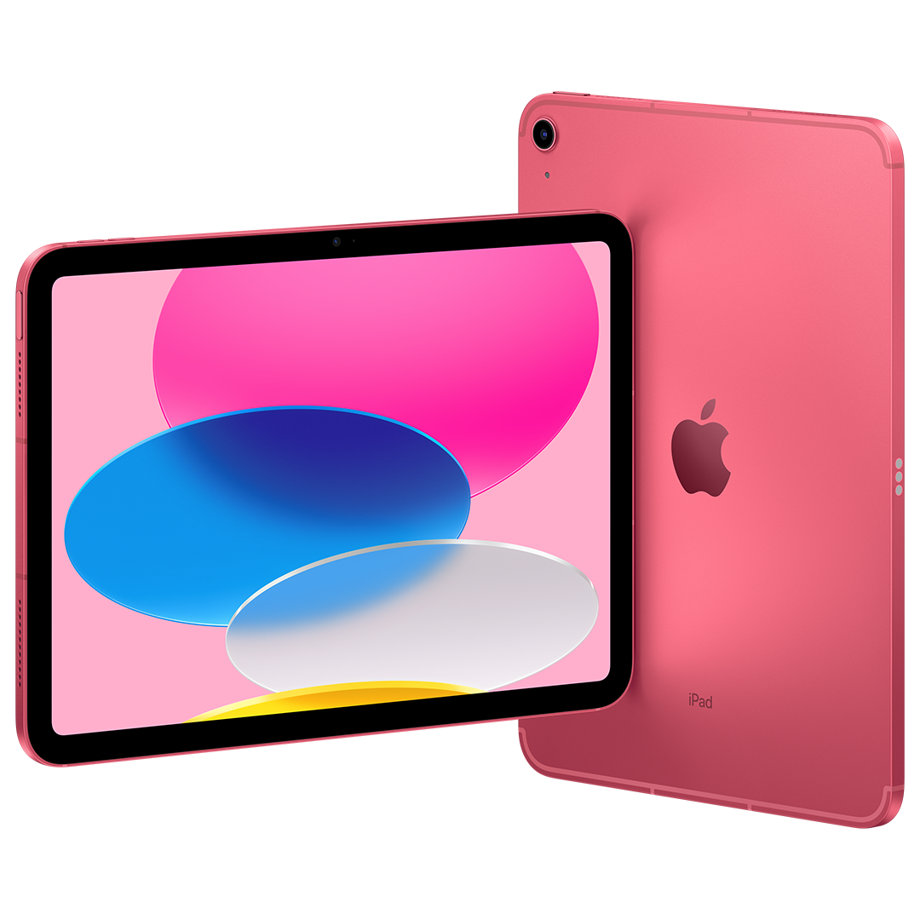
Welcome to the
DREAMS Lab!
Y3/Y4
iPads

Slide 4
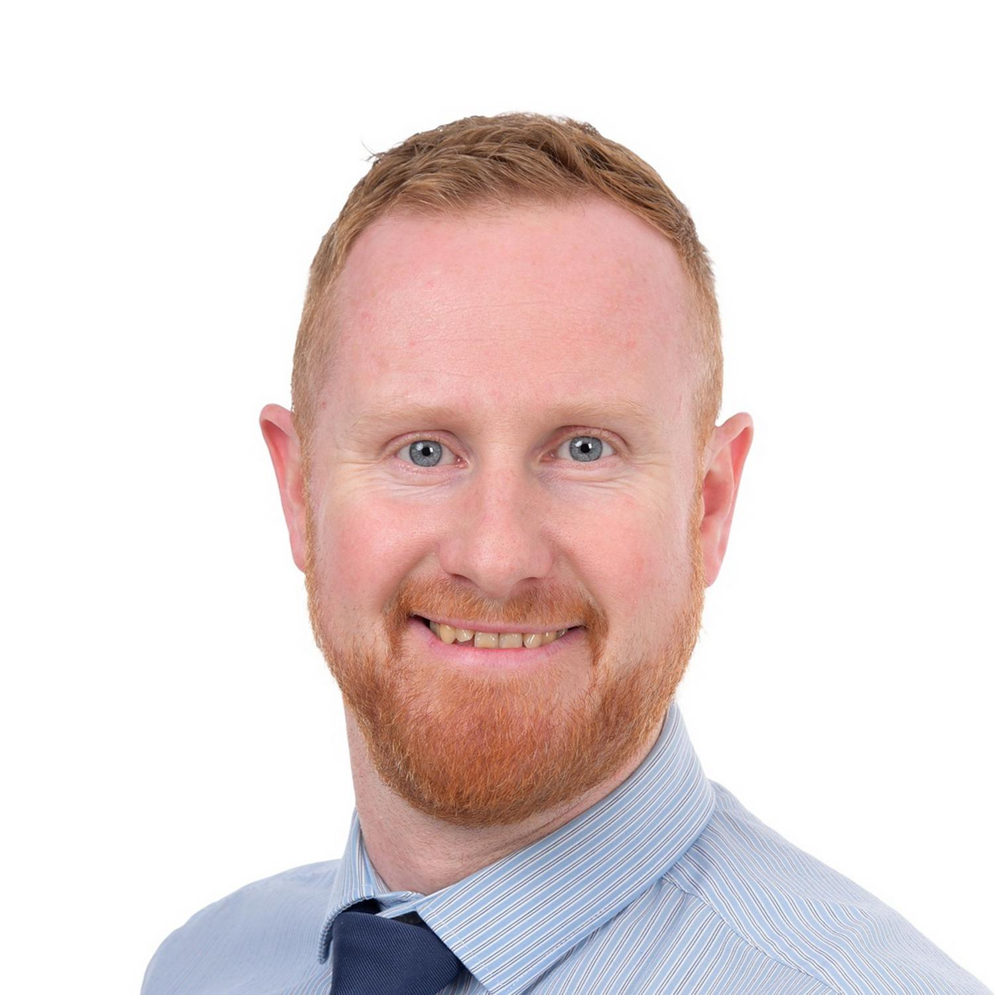
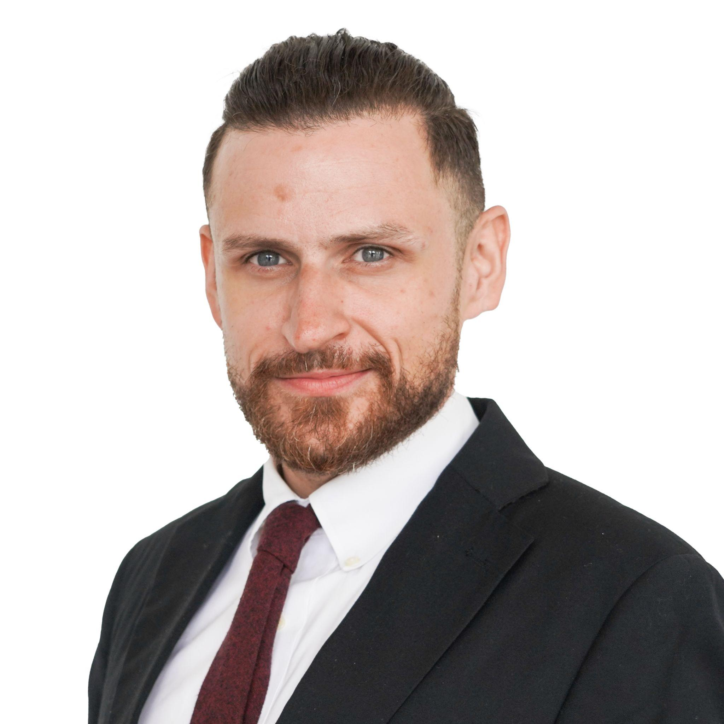
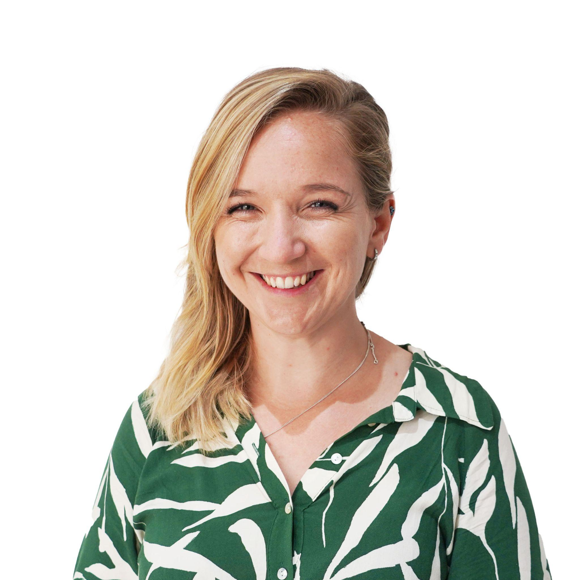
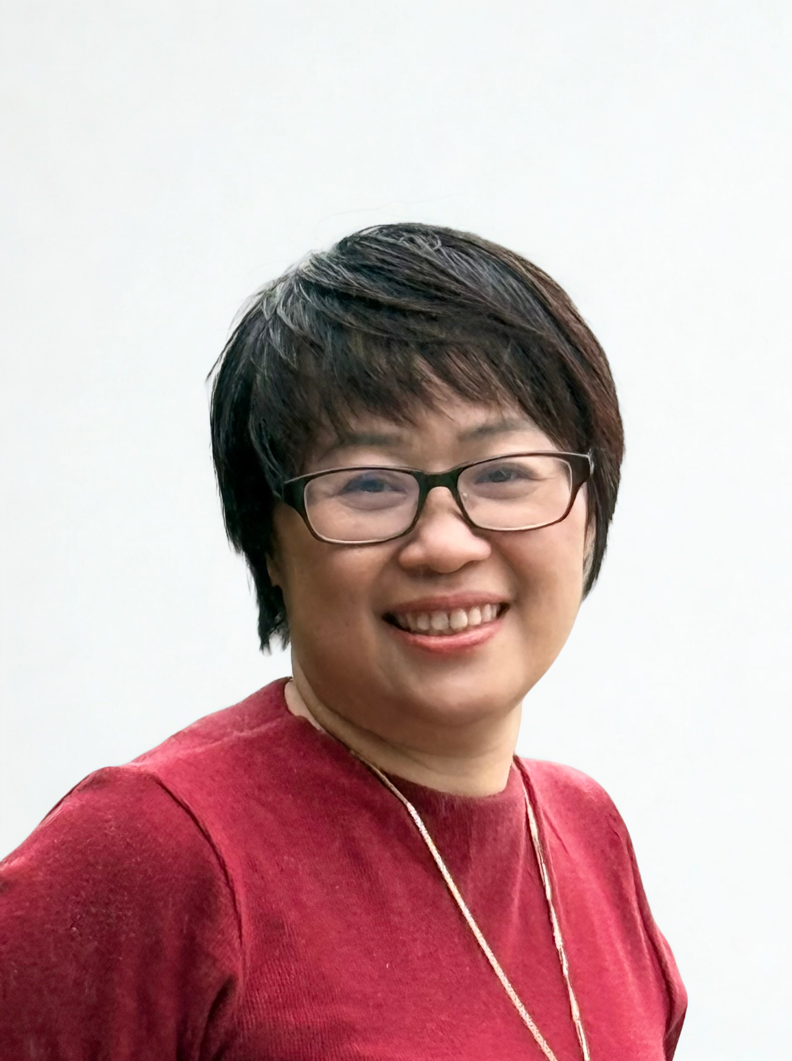
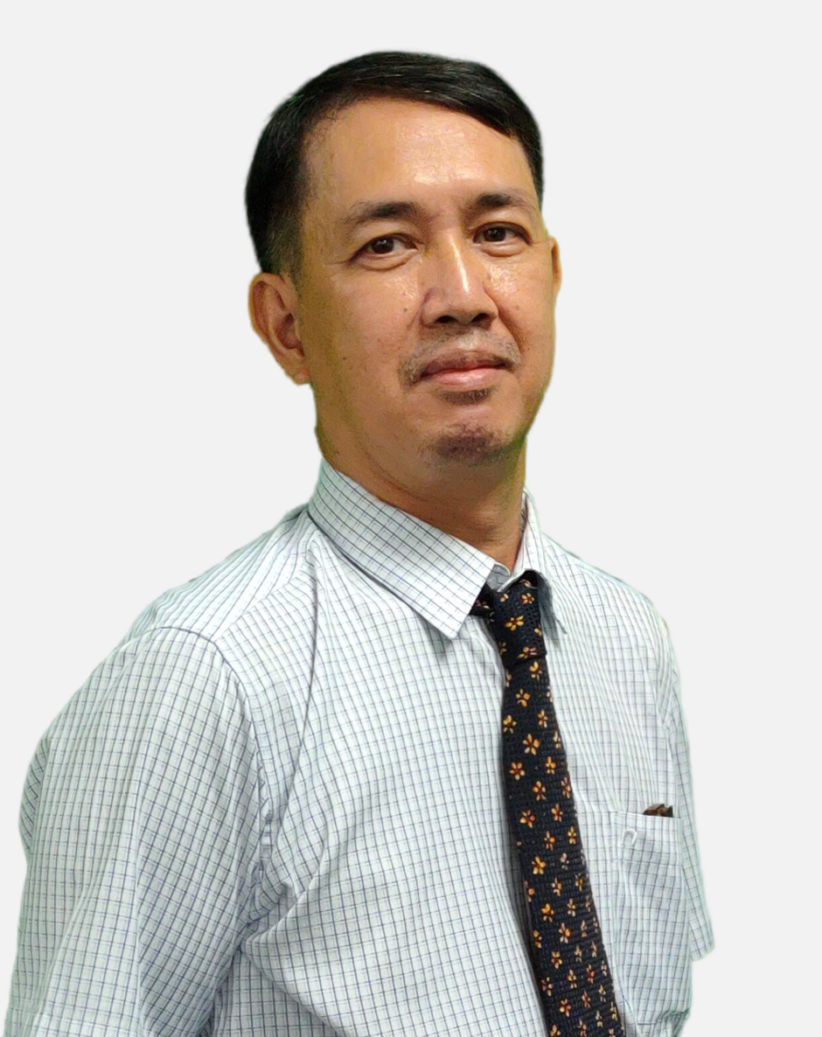
Meet the team
Mr Anthony
Head of ICT
Mr Patrick
Ms Rhian
Mr Tue
Ms Uyen

Slide 5
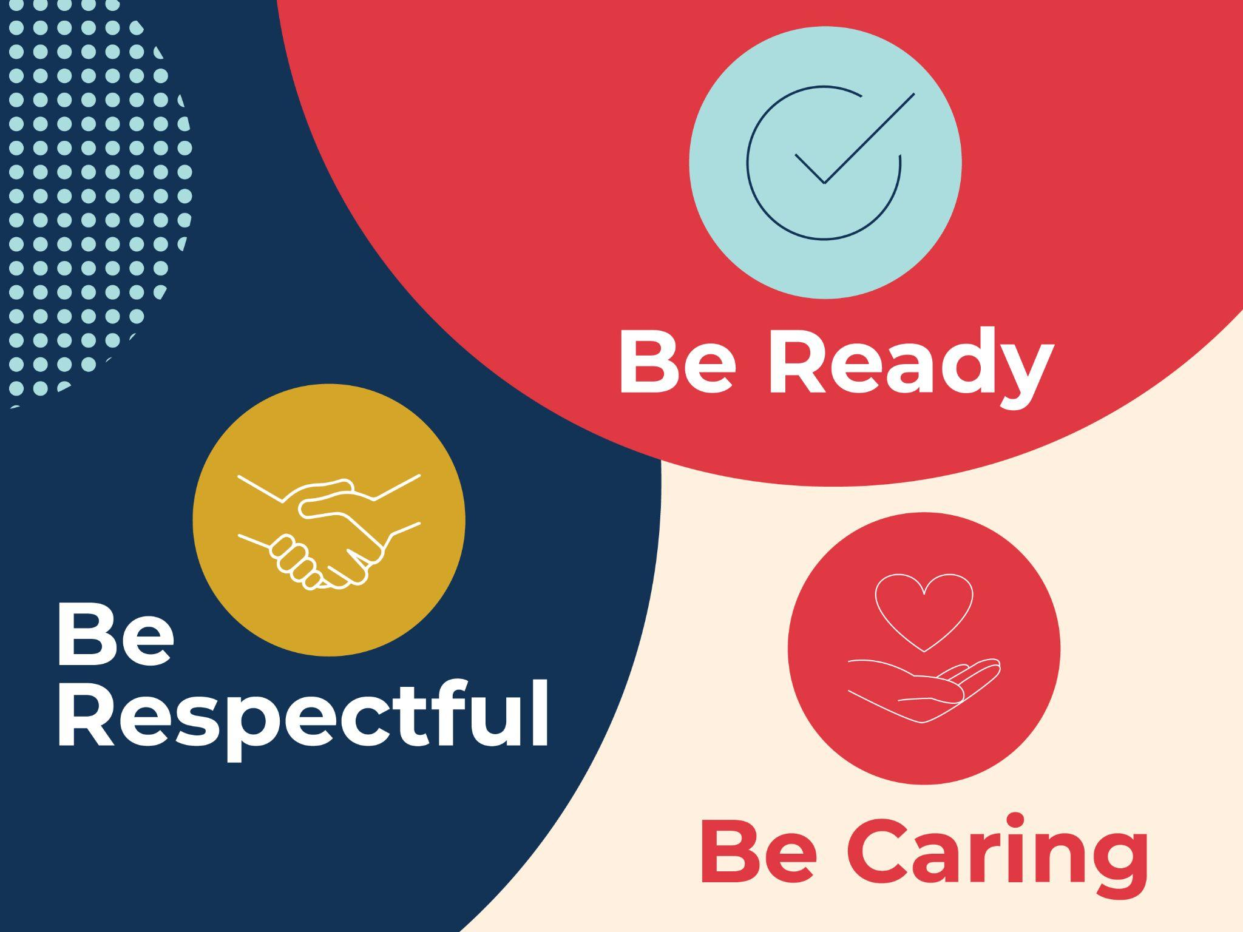
What do these look like in the DREAMS
Labs?

Slide 6
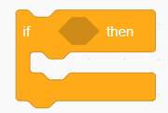
Dreams Lab Expectations

Slide 7

If…then…
…I should play on my iPad.
…I should speak loudly to my friends.
If I am waiting outside for my teacher, then….
…I should wait quietly against the wall.
…I should just go in and wait inside.
Notes:
Can stand up and go to the corner, nominate one person from each table to go to the corner or just point to the corner… depends on energy of class

Slide 8
If…then…
…. Sit and wait for someone to help me
…. I should play a random game on my iPad
If I am stuck and I don’t know what to do next, then….
….. Go and ask my Class teacher
…. C3 B4 Me
(ask 3 friends for help before asking your ICT Teacher)

Slide 9
If…then…
…. I will put my headphones in and stay quiet
…. I will stay quiet and let everyone else do the work
If I am asked to work with a partner or in a group, then….
…. I will listen to everyone and make sure everyone is involved
…. I will do all the work myself

Slide 10
If…then…
… my ICT teacher will give me 2 warnings before I need to sit out of the learning.
…. My parents will be asked to come in to school
If I am not ready, respectful, caring, then….
….. I can sing
…. I don’t need to listen in ICT, it’s ok

Slide 11

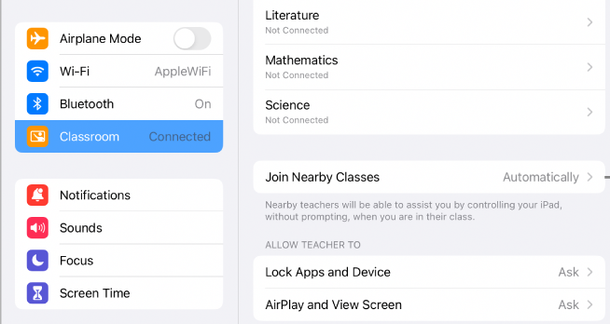
Setting up Apple Classroom
Turn WIFI on and connect to ‘EDUCATION’ network
Go to settings and look for the logo
Tap blue words Add/ join class e.g ‘3B ICT Mr Anthony’
Notes:
Student’s may not know their passwords yet. Provide them with the excel doc when provided by Maria

Slide 12
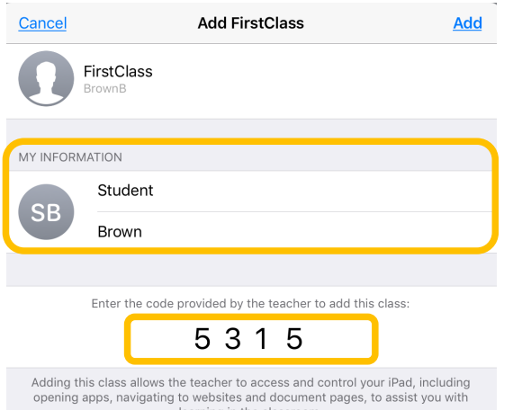
Setting up Apple Classroom
Enter the code you see on the screen
Write your first and last name
Tap add
ALLOW ALL permissions
Wait for teacher
X X X X
Notes:
Student’s may not know their passwords yet. Provide them with the excel doc when provided by Maria

Slide 13

Check, hands up who has this app?
Notes:
If less than half have it, don’t bother doing AUP until they sign up on laptops

Slide 14

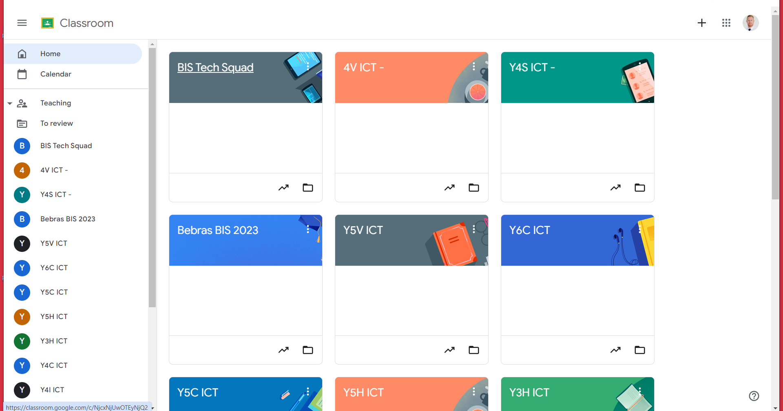
Join Google Classroom
Join Class

Slide 15
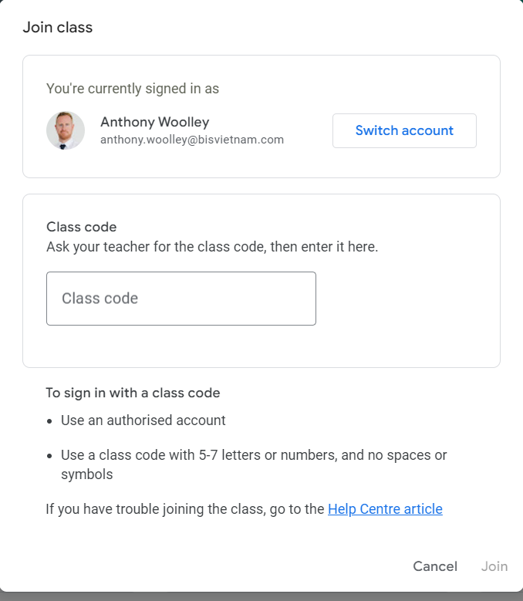
Enter class code

Slide 16
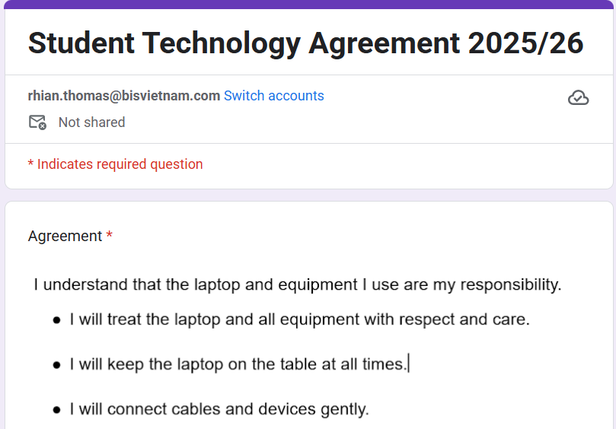
Agree and sign on Google Forms

Slide 17
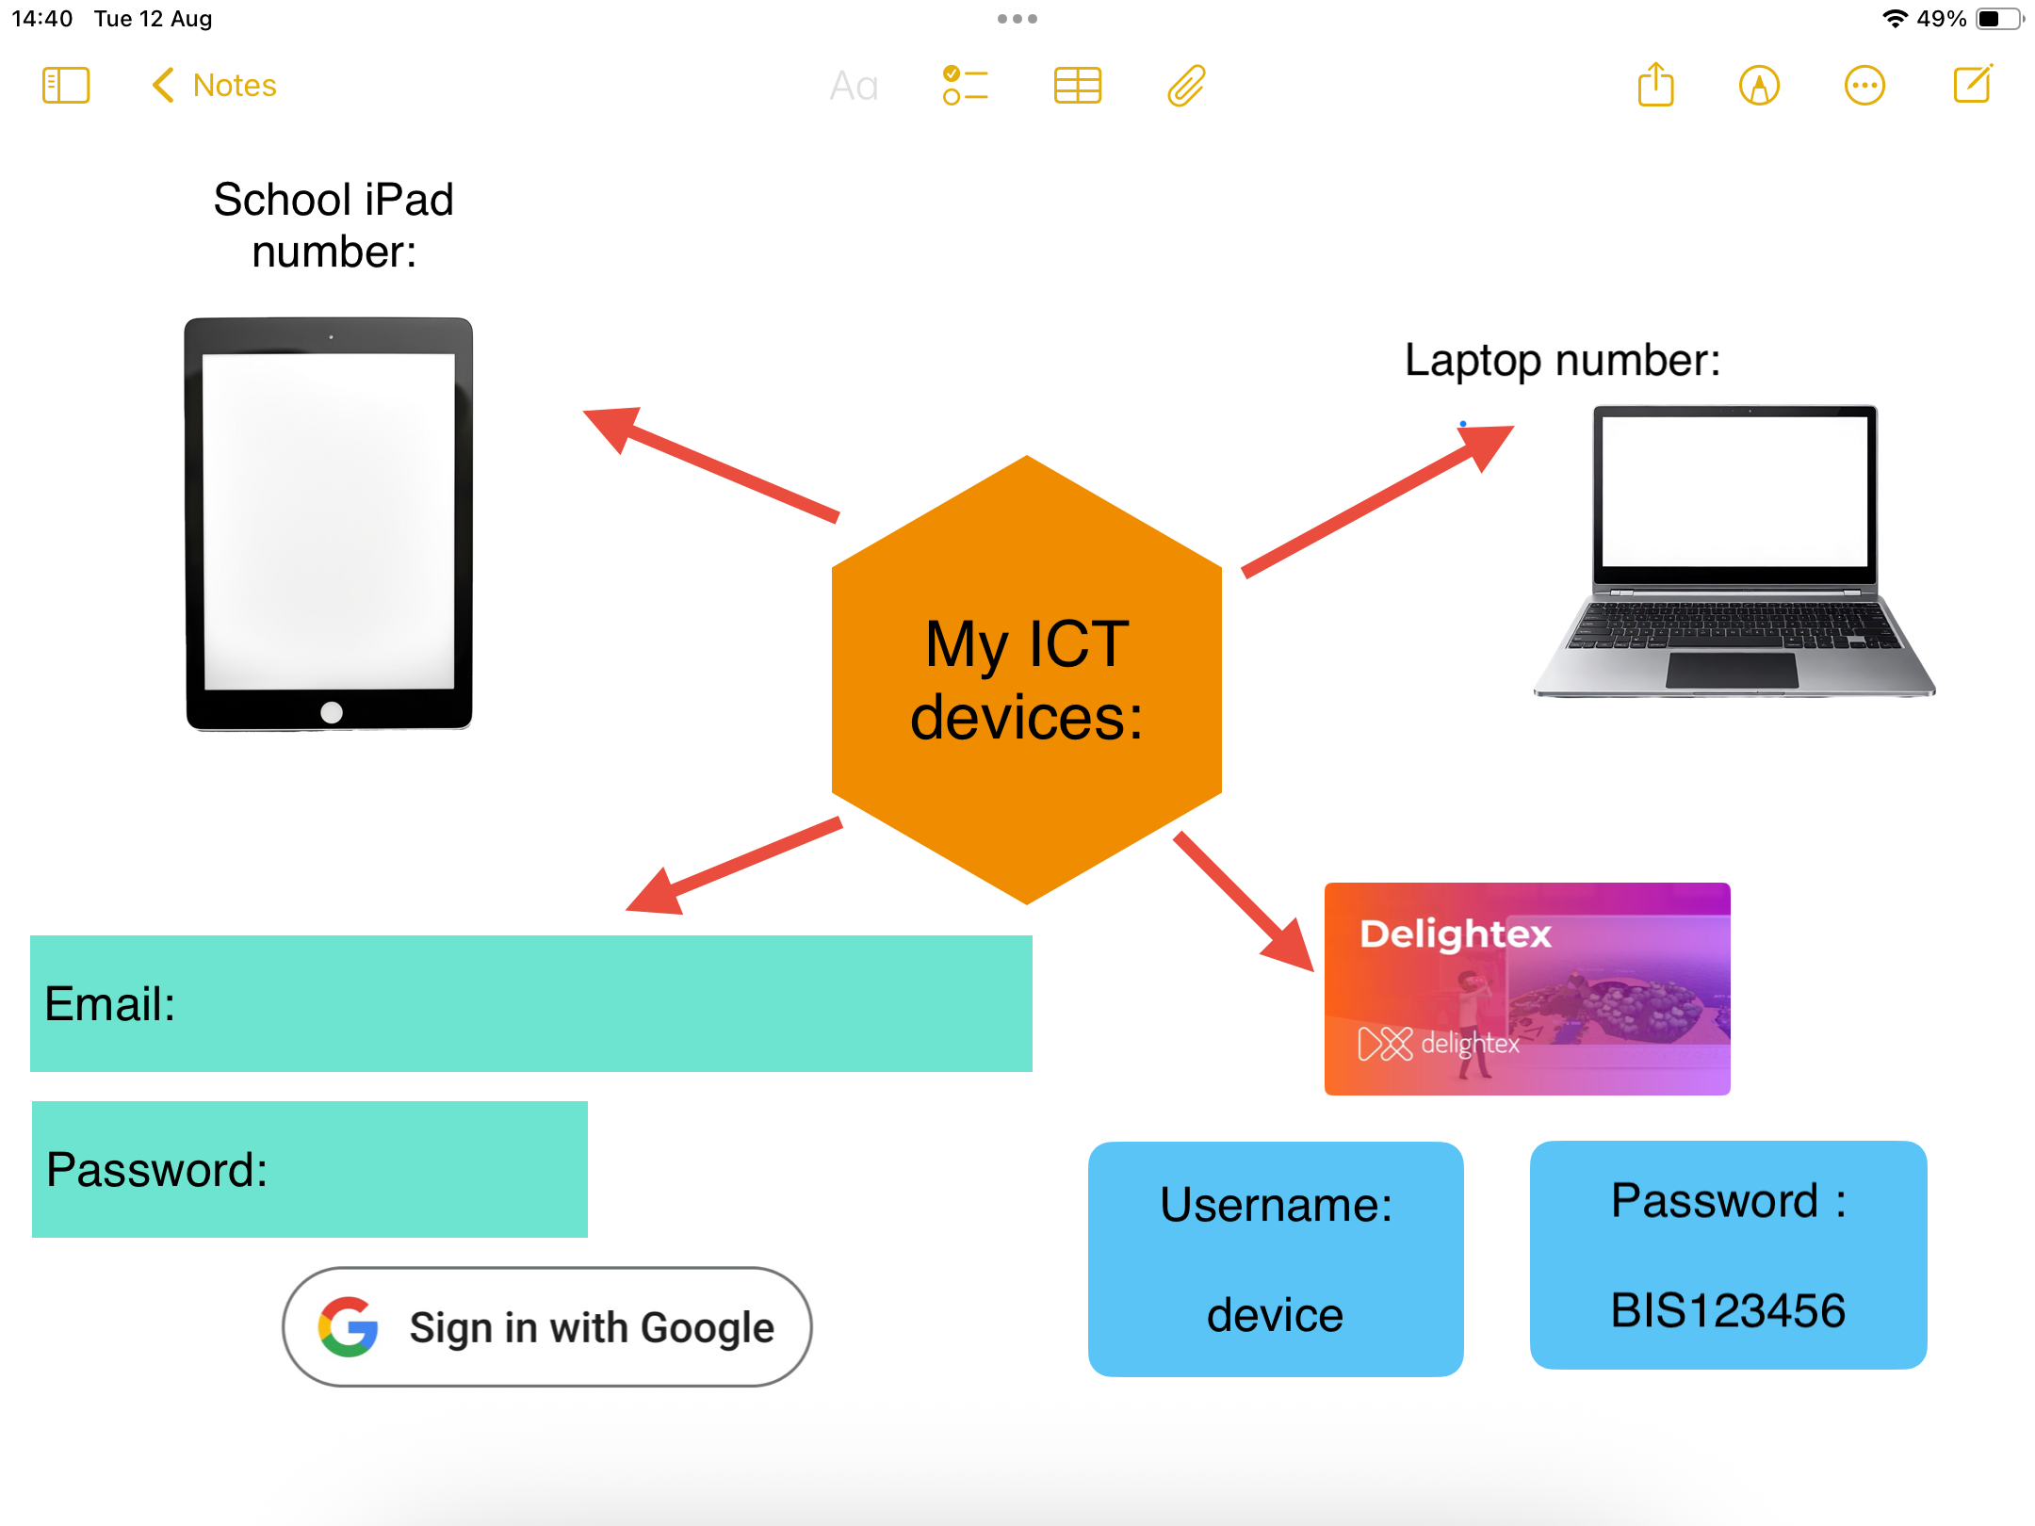
Notes:
Not worth it with Y3

Slide 18

Who has the Seesaw App?

Slide 19
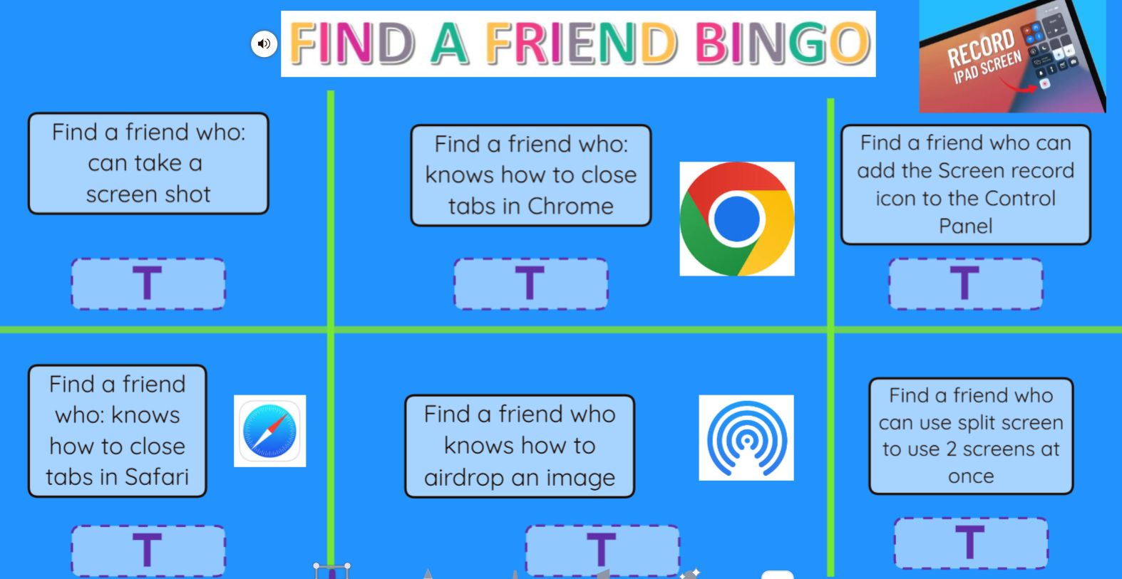
Notes:
Seesaw link

Slide 20
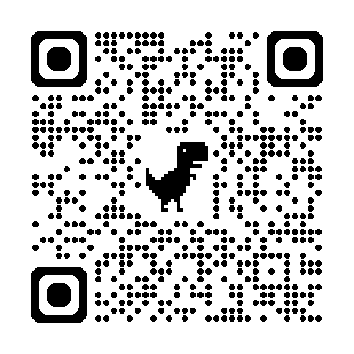
Mini Games Challenge!

Slide 21
Laptop related skills and knowledge
How to collect and return the laptops
Navigating the keyboard and special characters
How to log into the devices
How to sign into Chrome account
How to access the Google Apps for Learning
Bookmark google Classroom
Joining Google Classroom
Correct shutdown process
Completing the laptop agreement (laptop or ipad)
Notes:
Y3-4 Sites to pin to Google Classroom. TinkerCAd, Seesaw, Code.org, Make Code Arcade, Make Code microbit, Canva, Google Classroom, co-Spaces local editor,

Slide 22
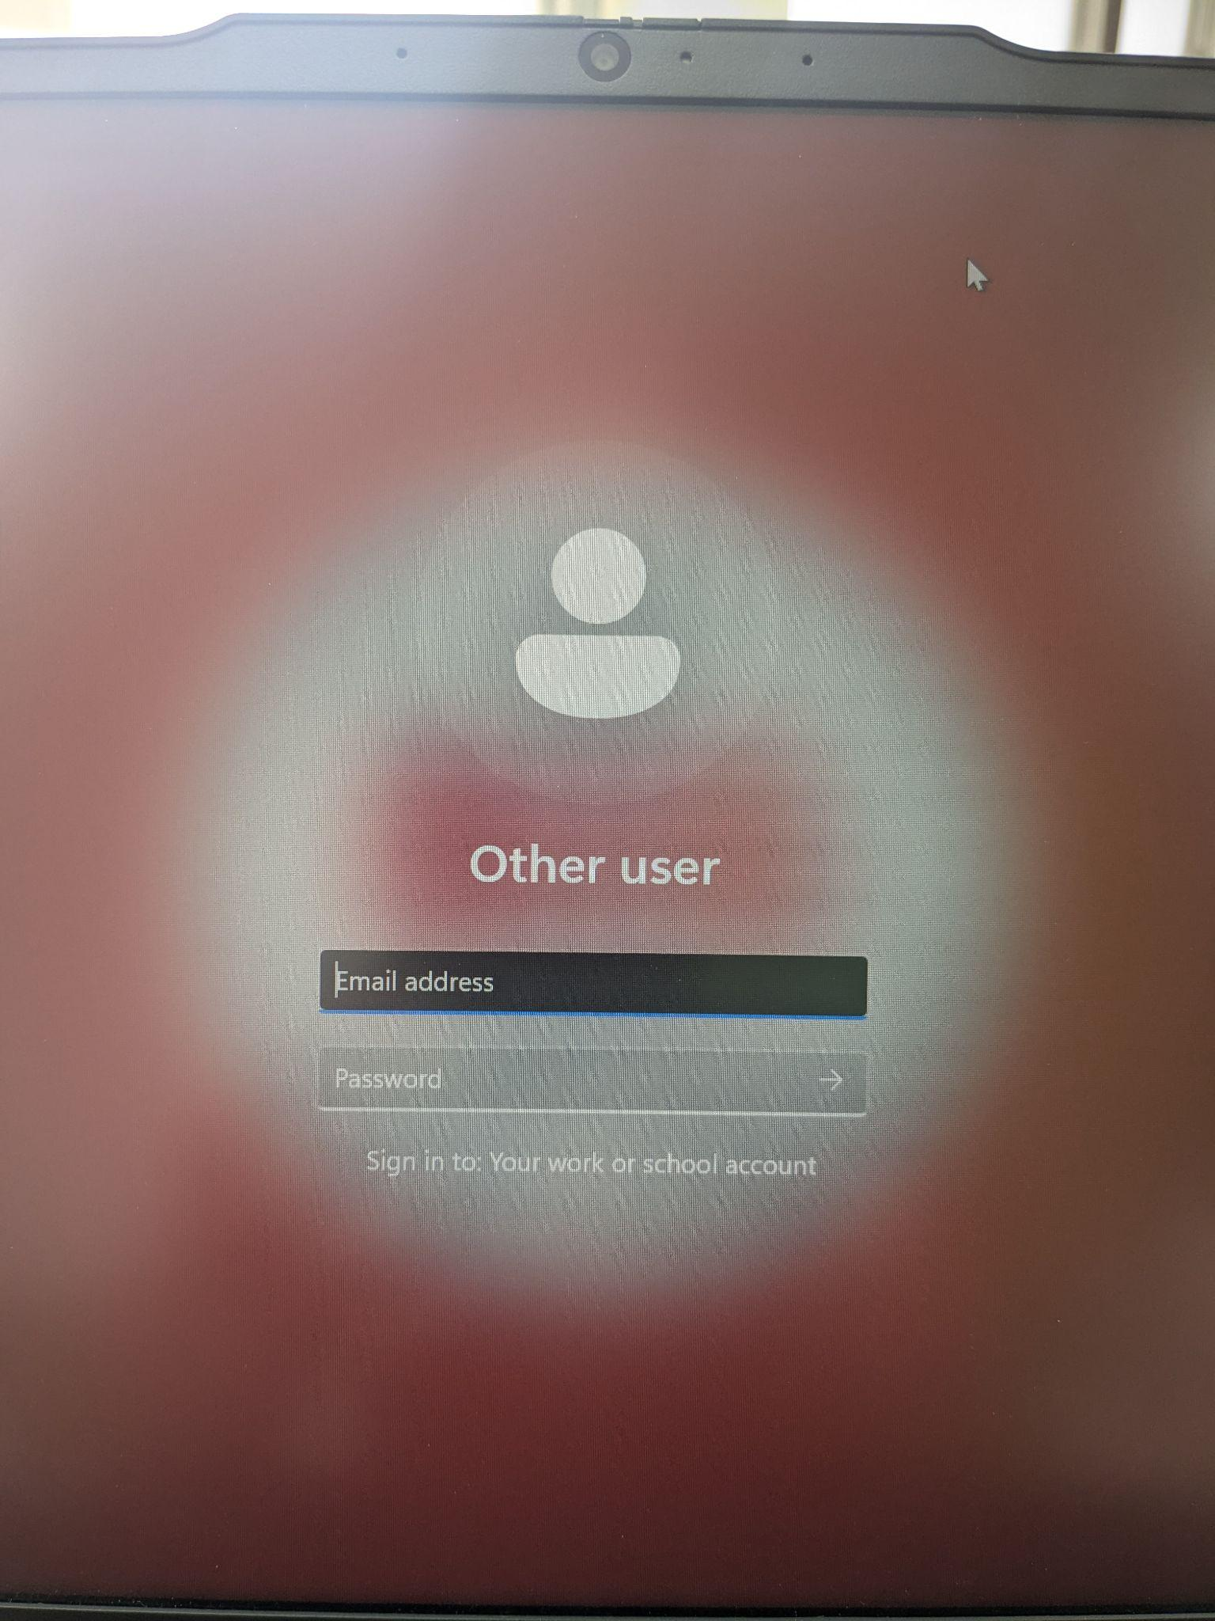
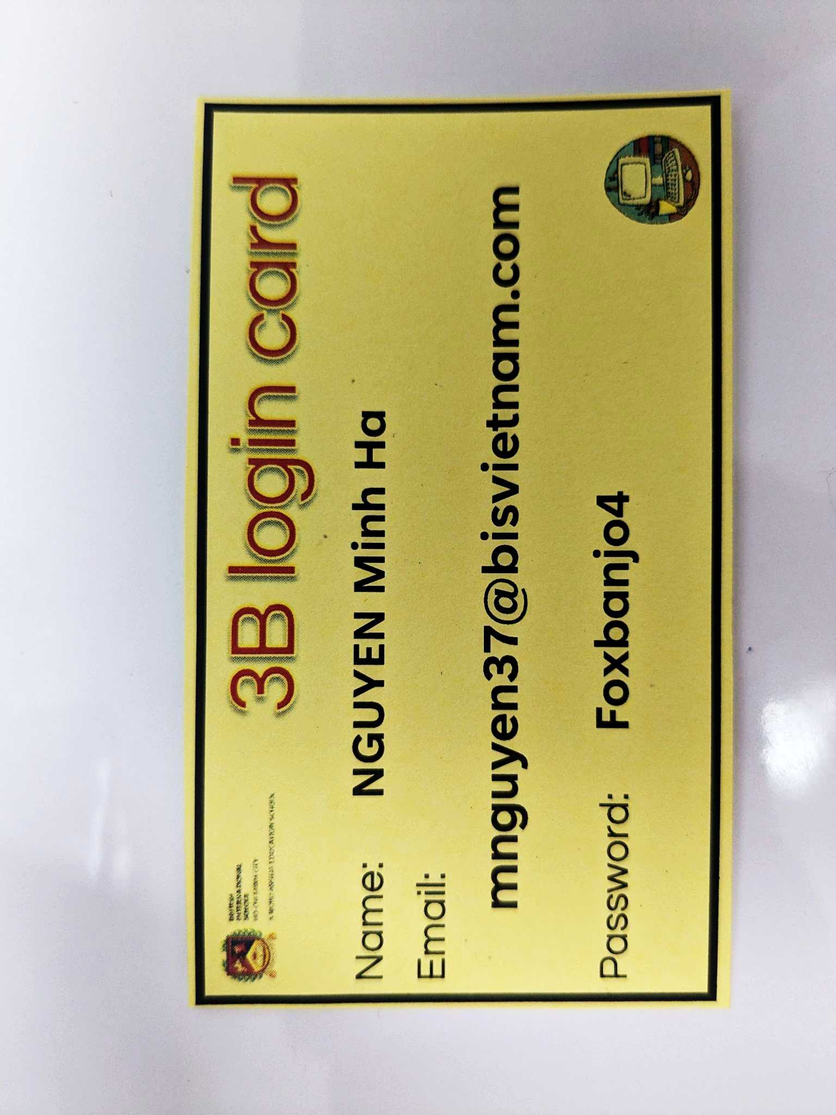
Logging in:
Login

Slide 23
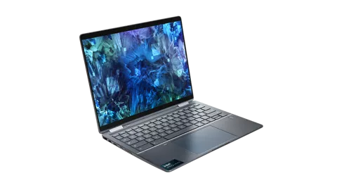
Welcome to the
DREAMS Lab Y3/Y4
Laptops

Slide 24
Meet the team
Mr Anthony
Head of ICT
Mr Patrick
Ms Rhian
Mr Tue
Ms Uyen

Slide 25
What do these look like in the DREAMS
Labs?

Slide 26
Dreams Lab Expectations

Slide 27
If…then…
…I should play on my iPad.
…I should speak loudly to my friends.
If I am waiting outside for my teacher, then….
…I should wait quietly against the wall.
…I should just go in and wait inside.
Notes:
Can stand up and go to the corner, nominate one person from each table to go to the corner or just point to the corner… depends on energy of class

Slide 28
If…then…
…. Sit and wait for someone to help me
…. I should play a random game on my iPad
If I am stuck and I don’t know what to do next, then….
….. Go and ask my Class teacher
…. C3 B4 Me
(ask 3 friends for help before asking your ICT Teacher)

Slide 29
If…then…
…. I will put my headphones in and stay quiet
…. I will stay quiet and let everyone else do the work
If I am asked to work with a partner or in a group, then….
…. I will listen to everyone and make sure everyone is involved
…. I will do all the work myself

Slide 30
If…then…
… my ICT teacher will give me 2 warnings before I need to sit out of the learning.
…. My parents will be asked to come in to school
If I am not showing respect, care and showing I am ready, then….
….. I can sing
…. I don’t need to listen in ICT, it’s ok

Slide 31
Check the Classroom Screen to see your Laptop Number!

Slide 32

Open the lid, don’t turn it on yet!
Notes:
Display Laptop number on Classroom screen

Slide 33
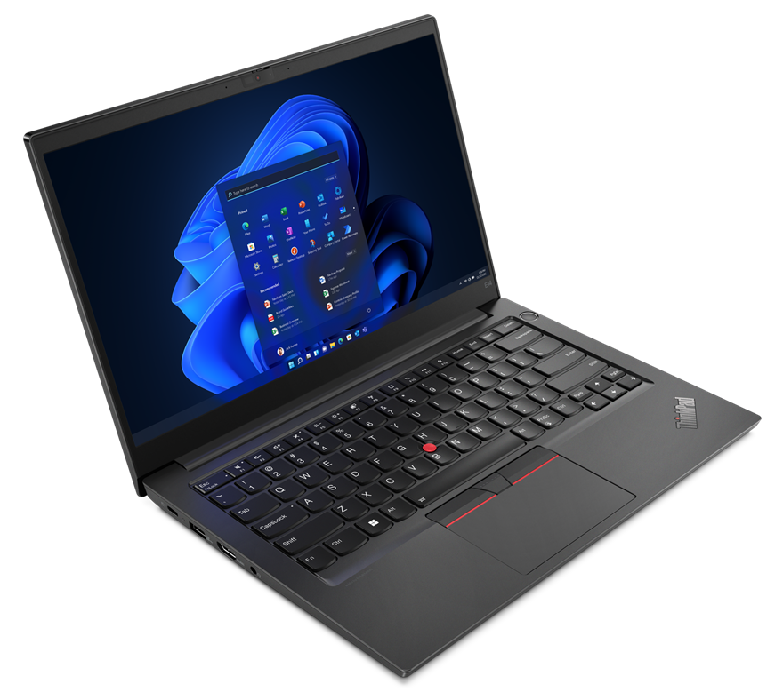
Let’s take a tour:
Can you point to:
On/Off button
Charging port
Trackpad
Trackpoint- pointing stick
Headphones port

Slide 34
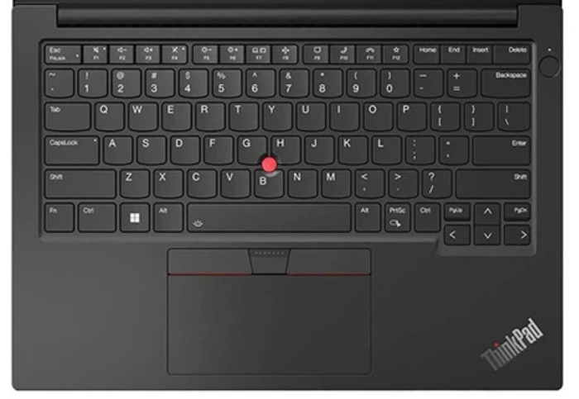

2. Press @
1.Press and hold on Shift

Slide 35
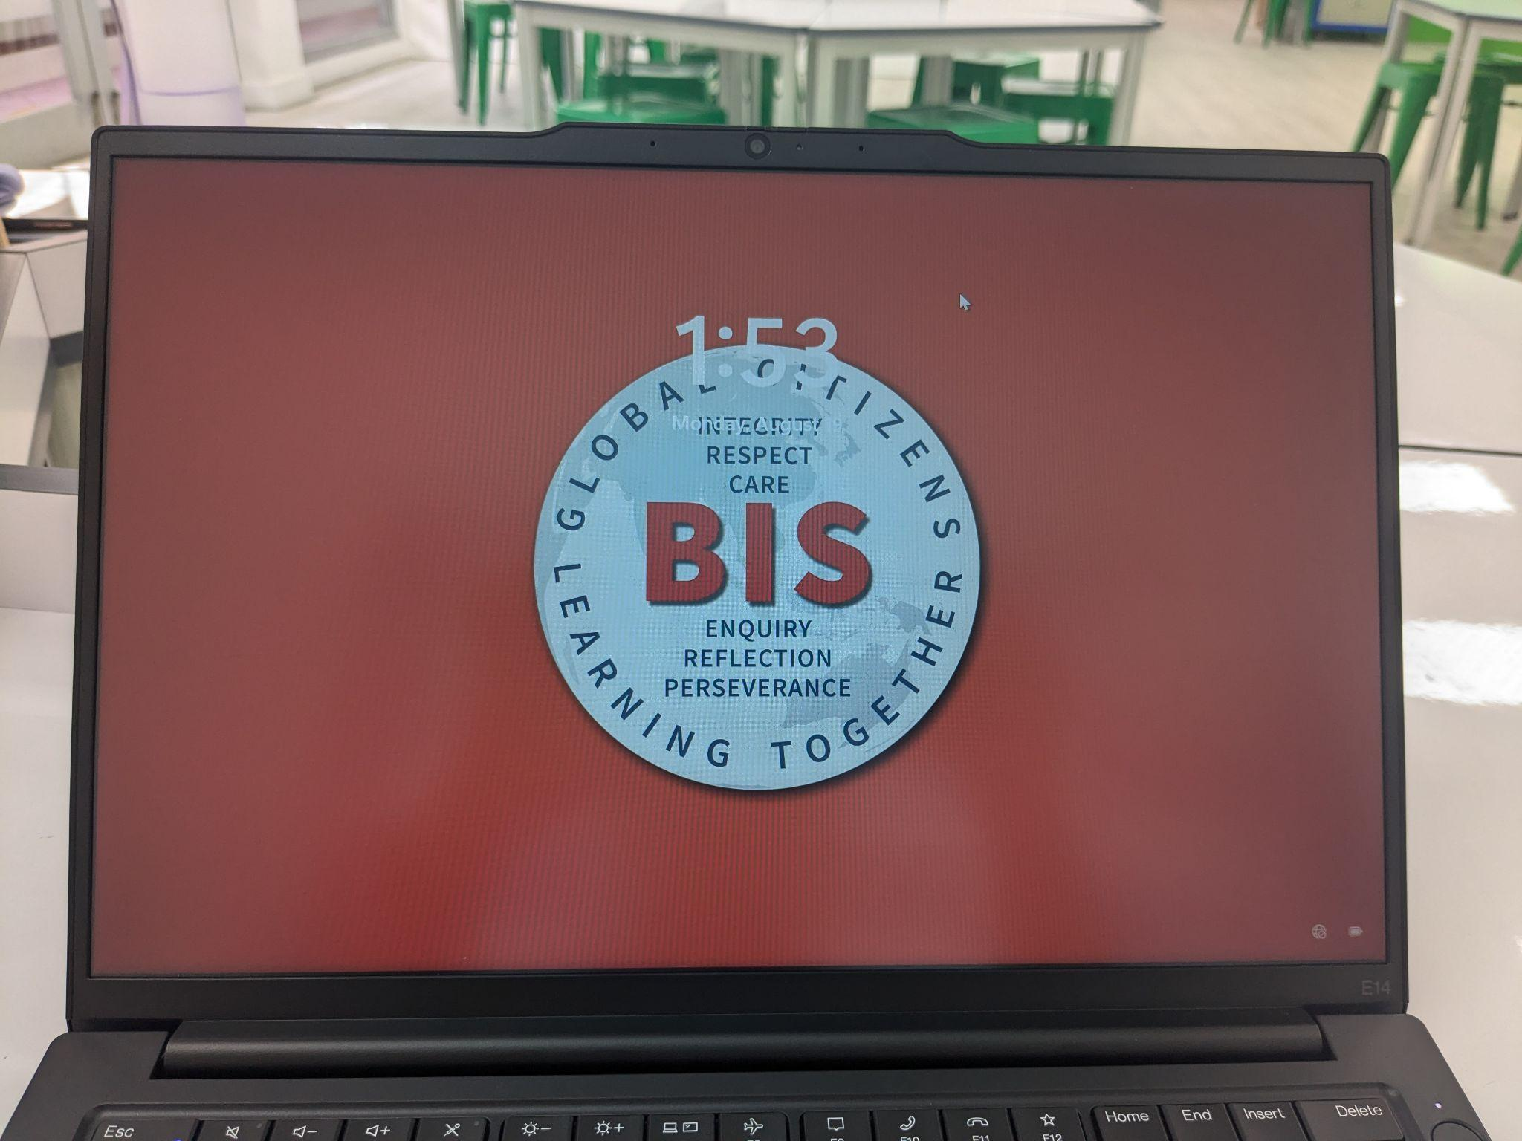
Let’s get started:
On button
Wait for BIS logo
Press Enter
Are you on the DREAMS LAB wifi?
Notes:
This will only be for your first class but the next ones may have to ‘connect’ to EDUCATION

Slide 36
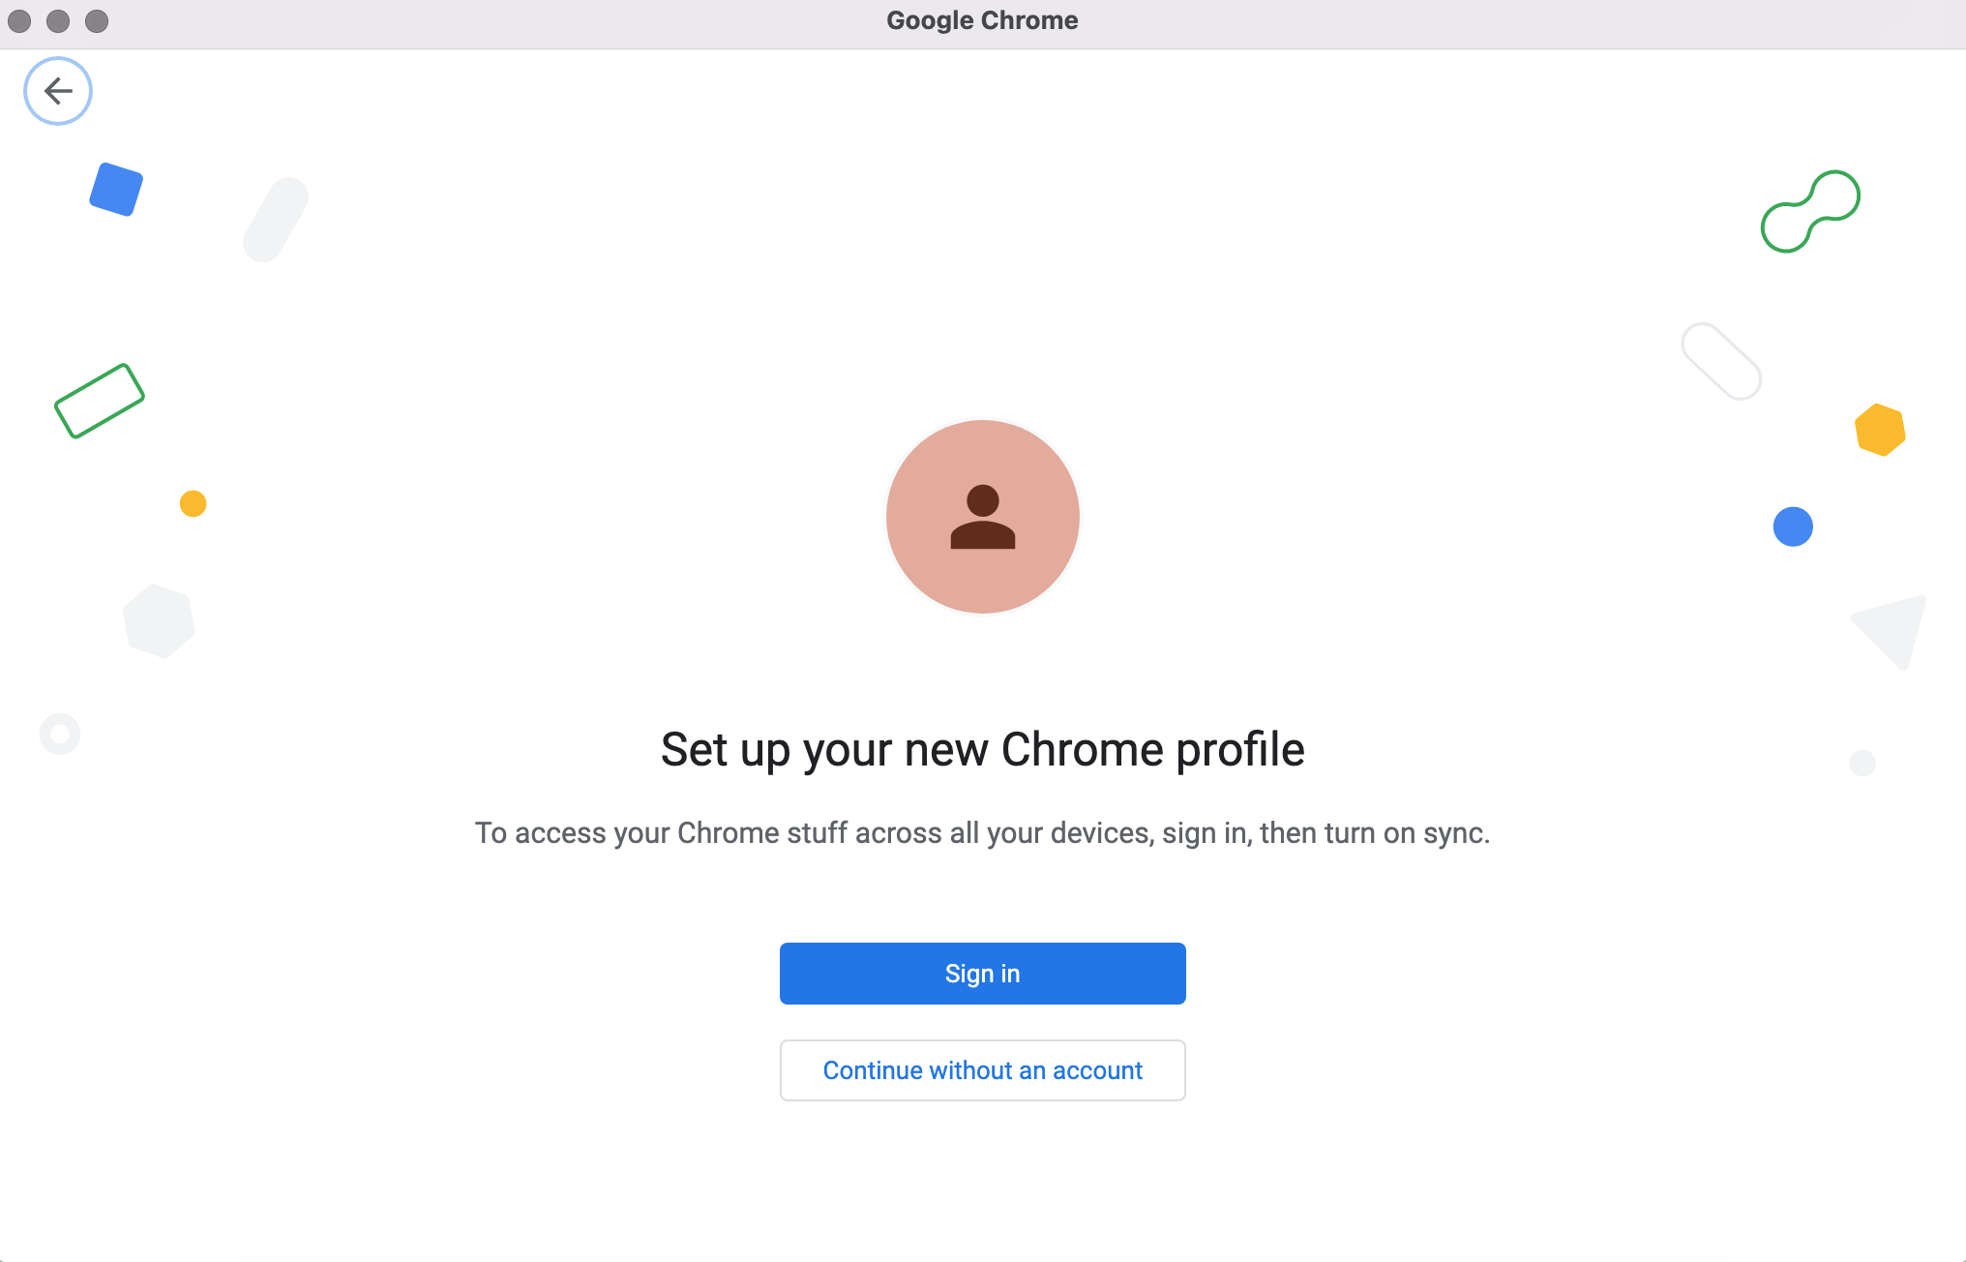

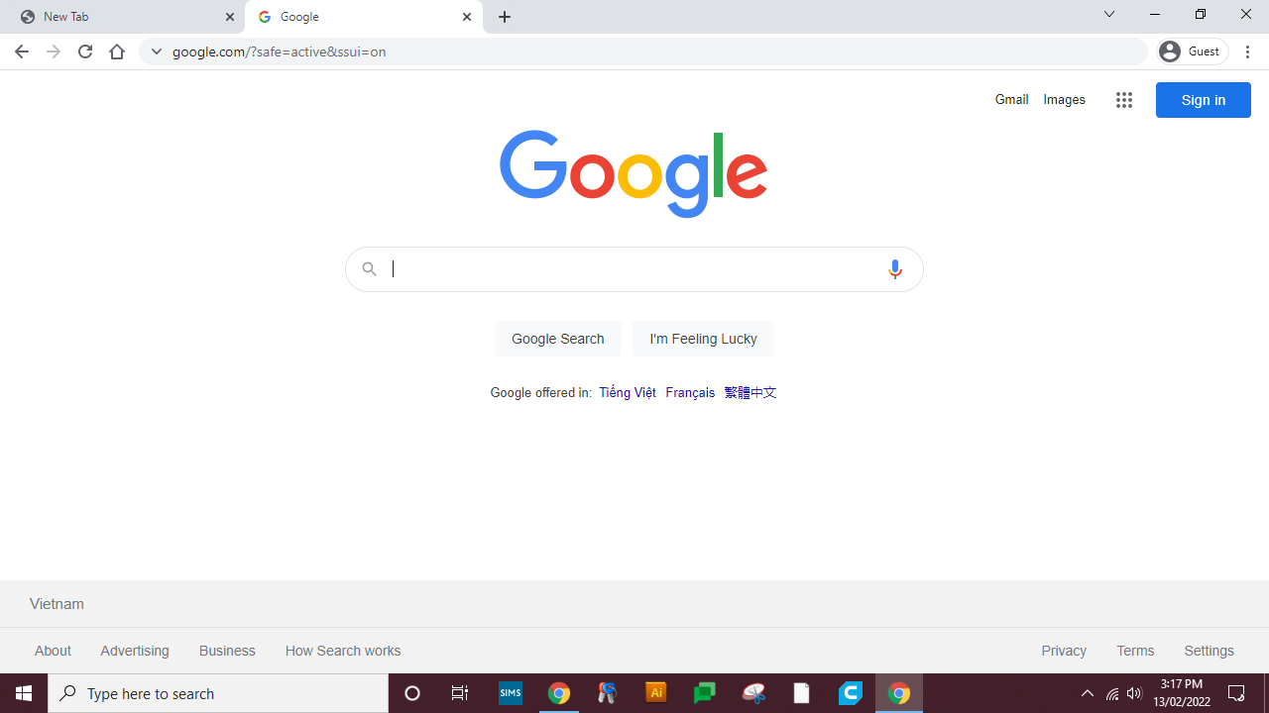
Click Here
Please make sure your language is set to English

Slide 37
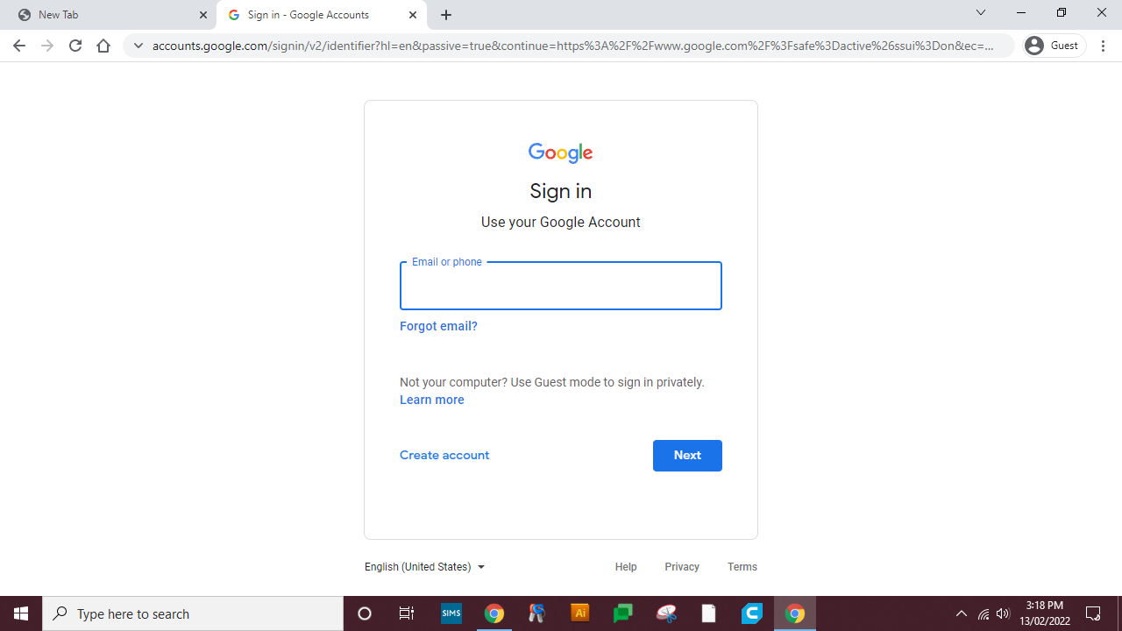
Type your Email Here

Slide 38
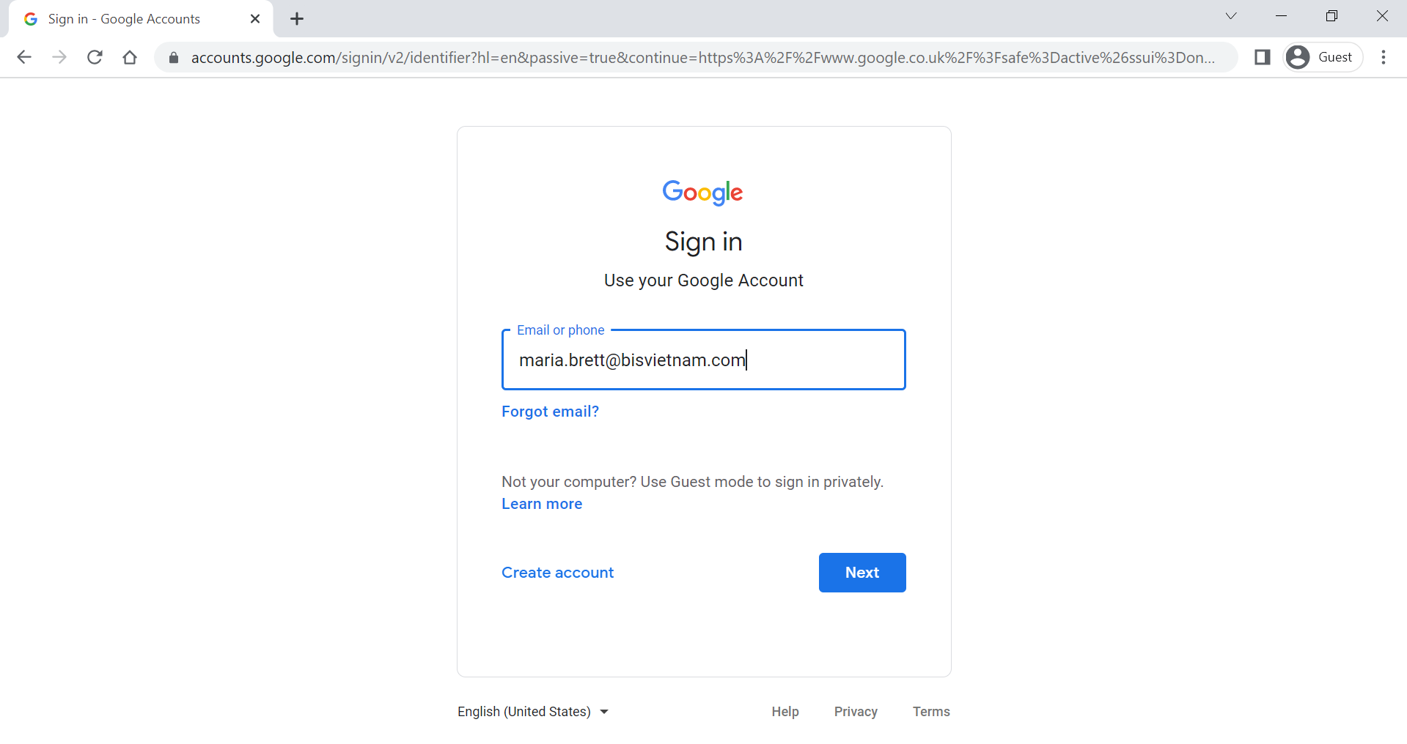
Click Here

Slide 39
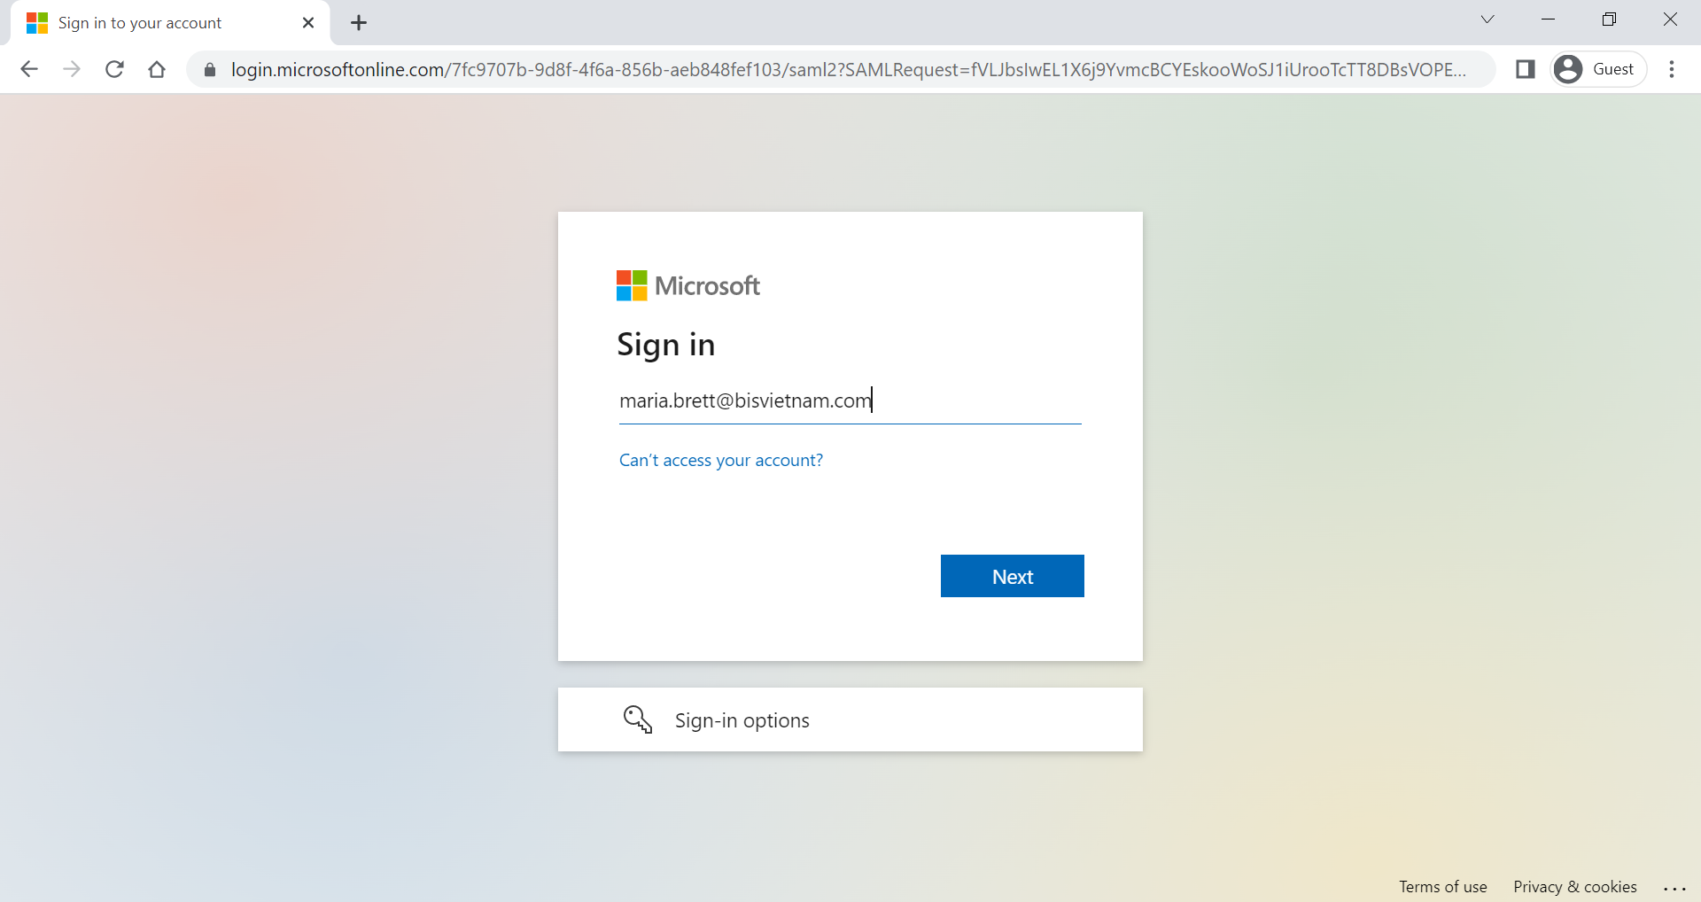
Type your Email Here

Slide 40
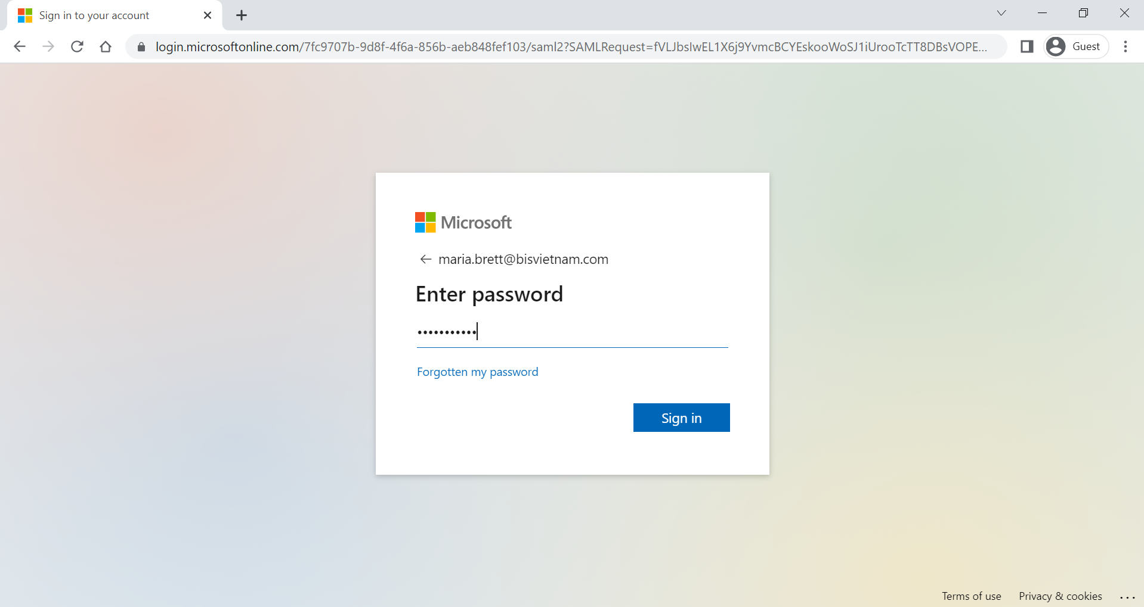
Click Here

Slide 41
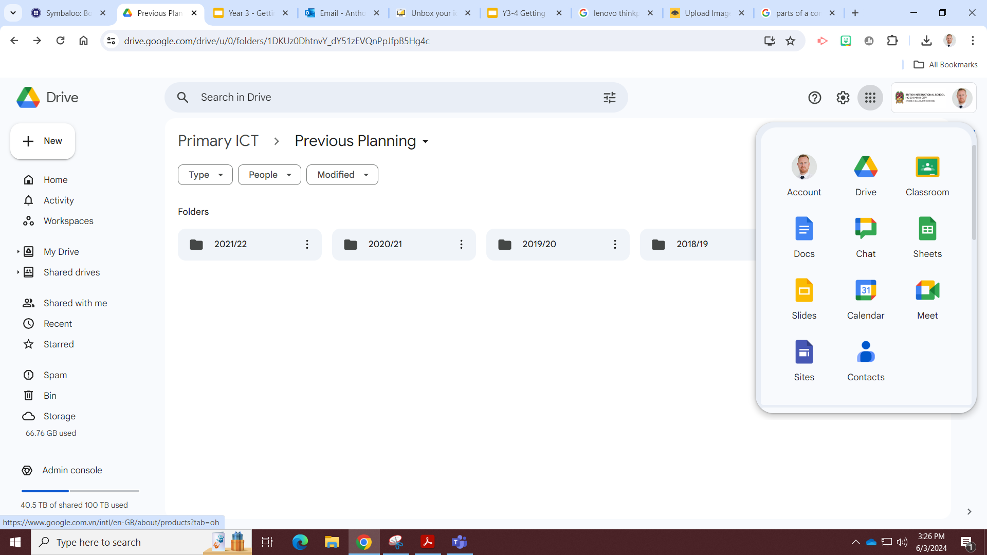
The Waffle

Slide 42
Join Google Classroom
Join Class

Slide 43
Enter class code

Slide 44
Agree and sign on Google Forms

Slide 45

Do you know how to Bookmark Google Classroom?
Notes:
Chalk and Talk

Slide 46
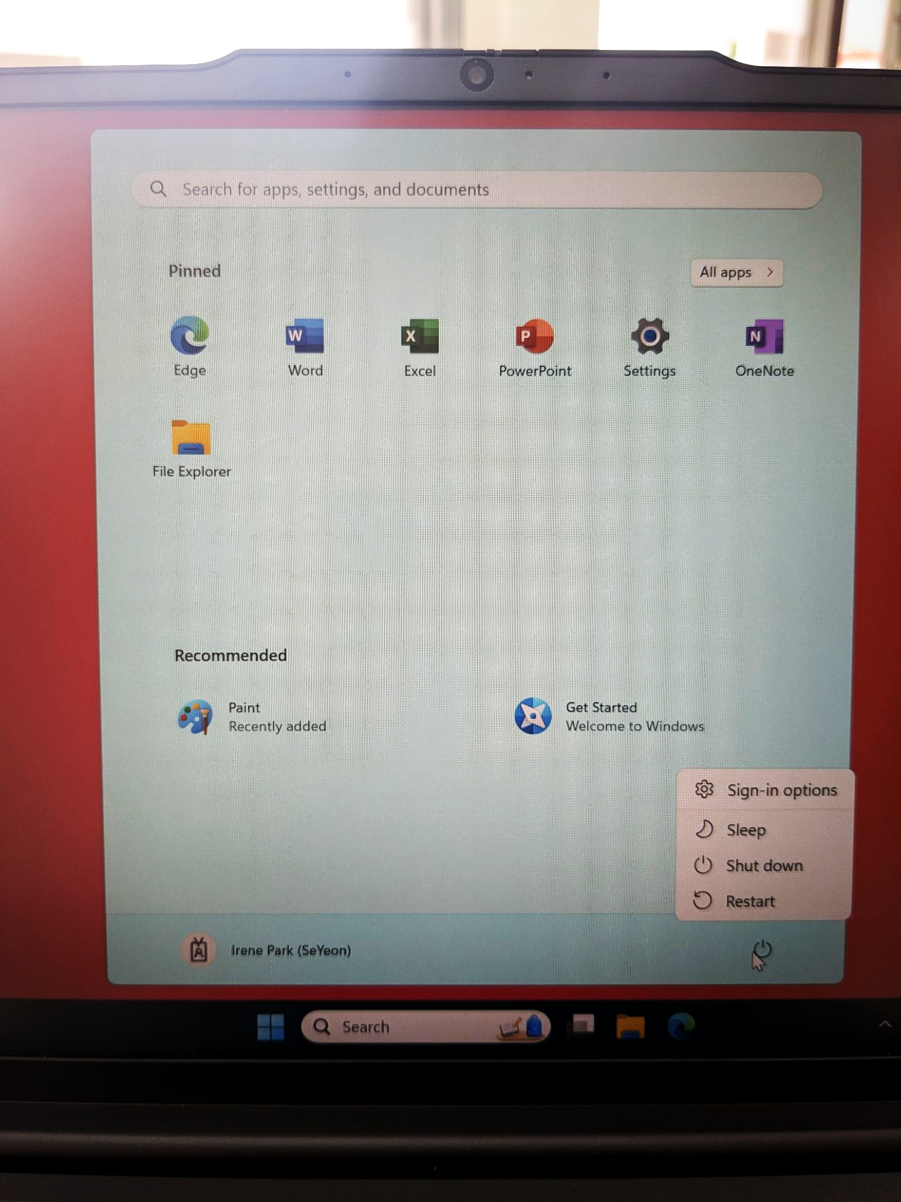
Shut down your laptop:
After every lesson please shut the laptop down so it is ready for the next person!

Slide 47
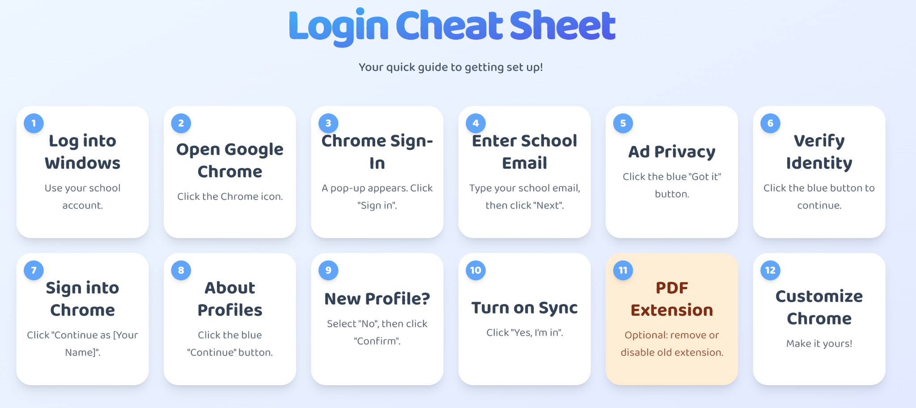
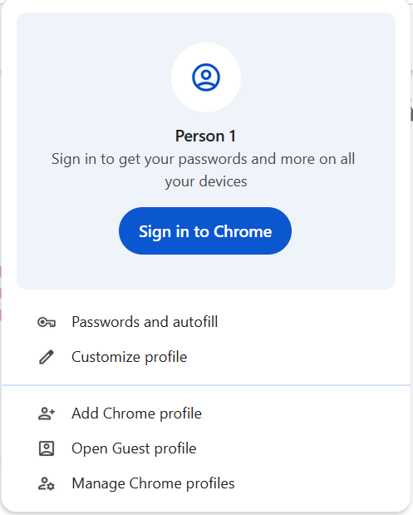



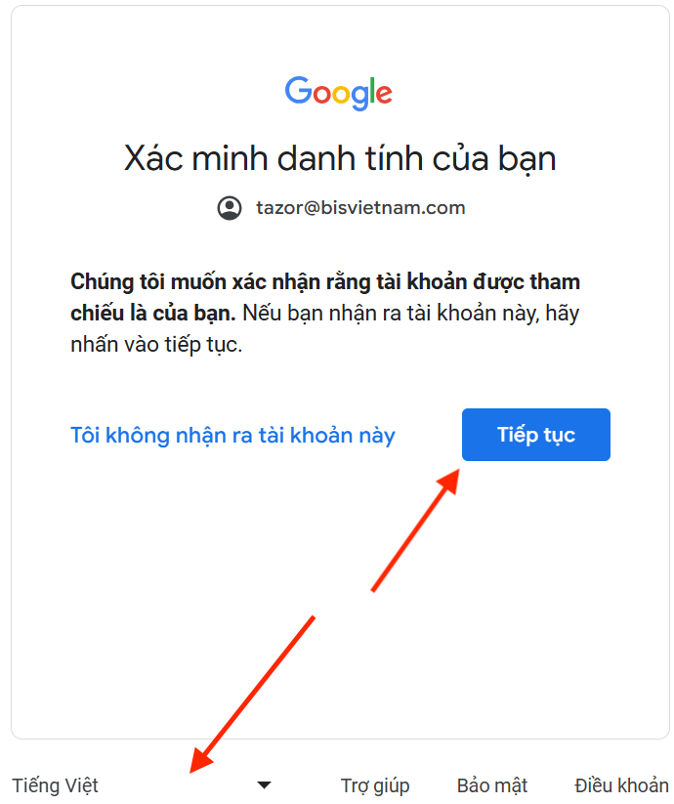

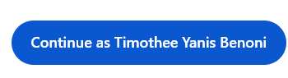
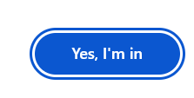
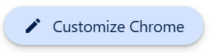
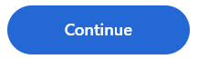
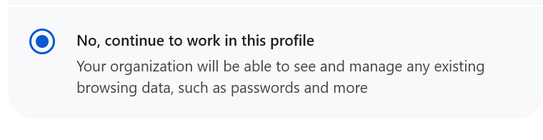
Your name

Slide 48
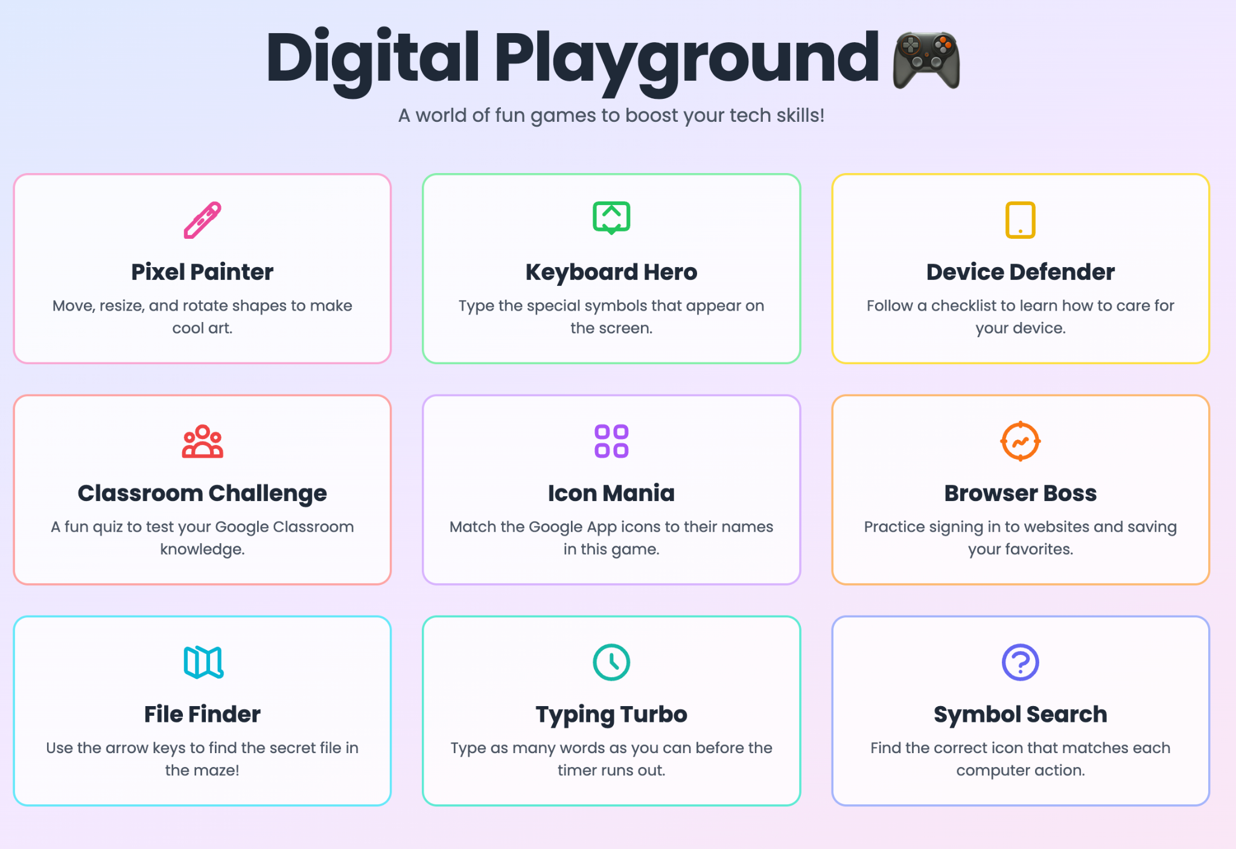
Notes:
Extension tasks
https://digital-playground-fun-tech-games-y3-4-ipad-801886913830.us-west1.run.app/
Alternative (easy)
https://edufun-mini-games-y3-4-801886913830.us-west1.run.app/#/

Slide 49
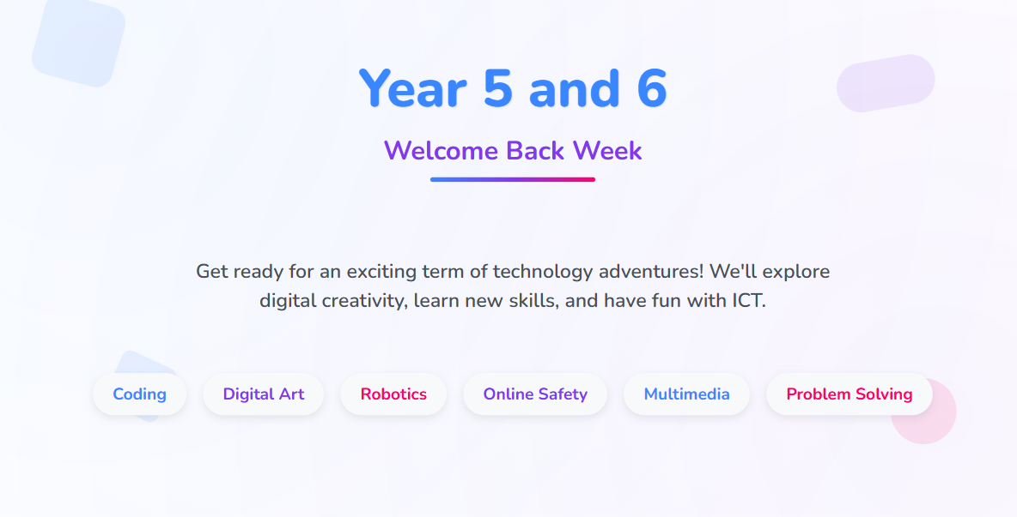

Slide 50
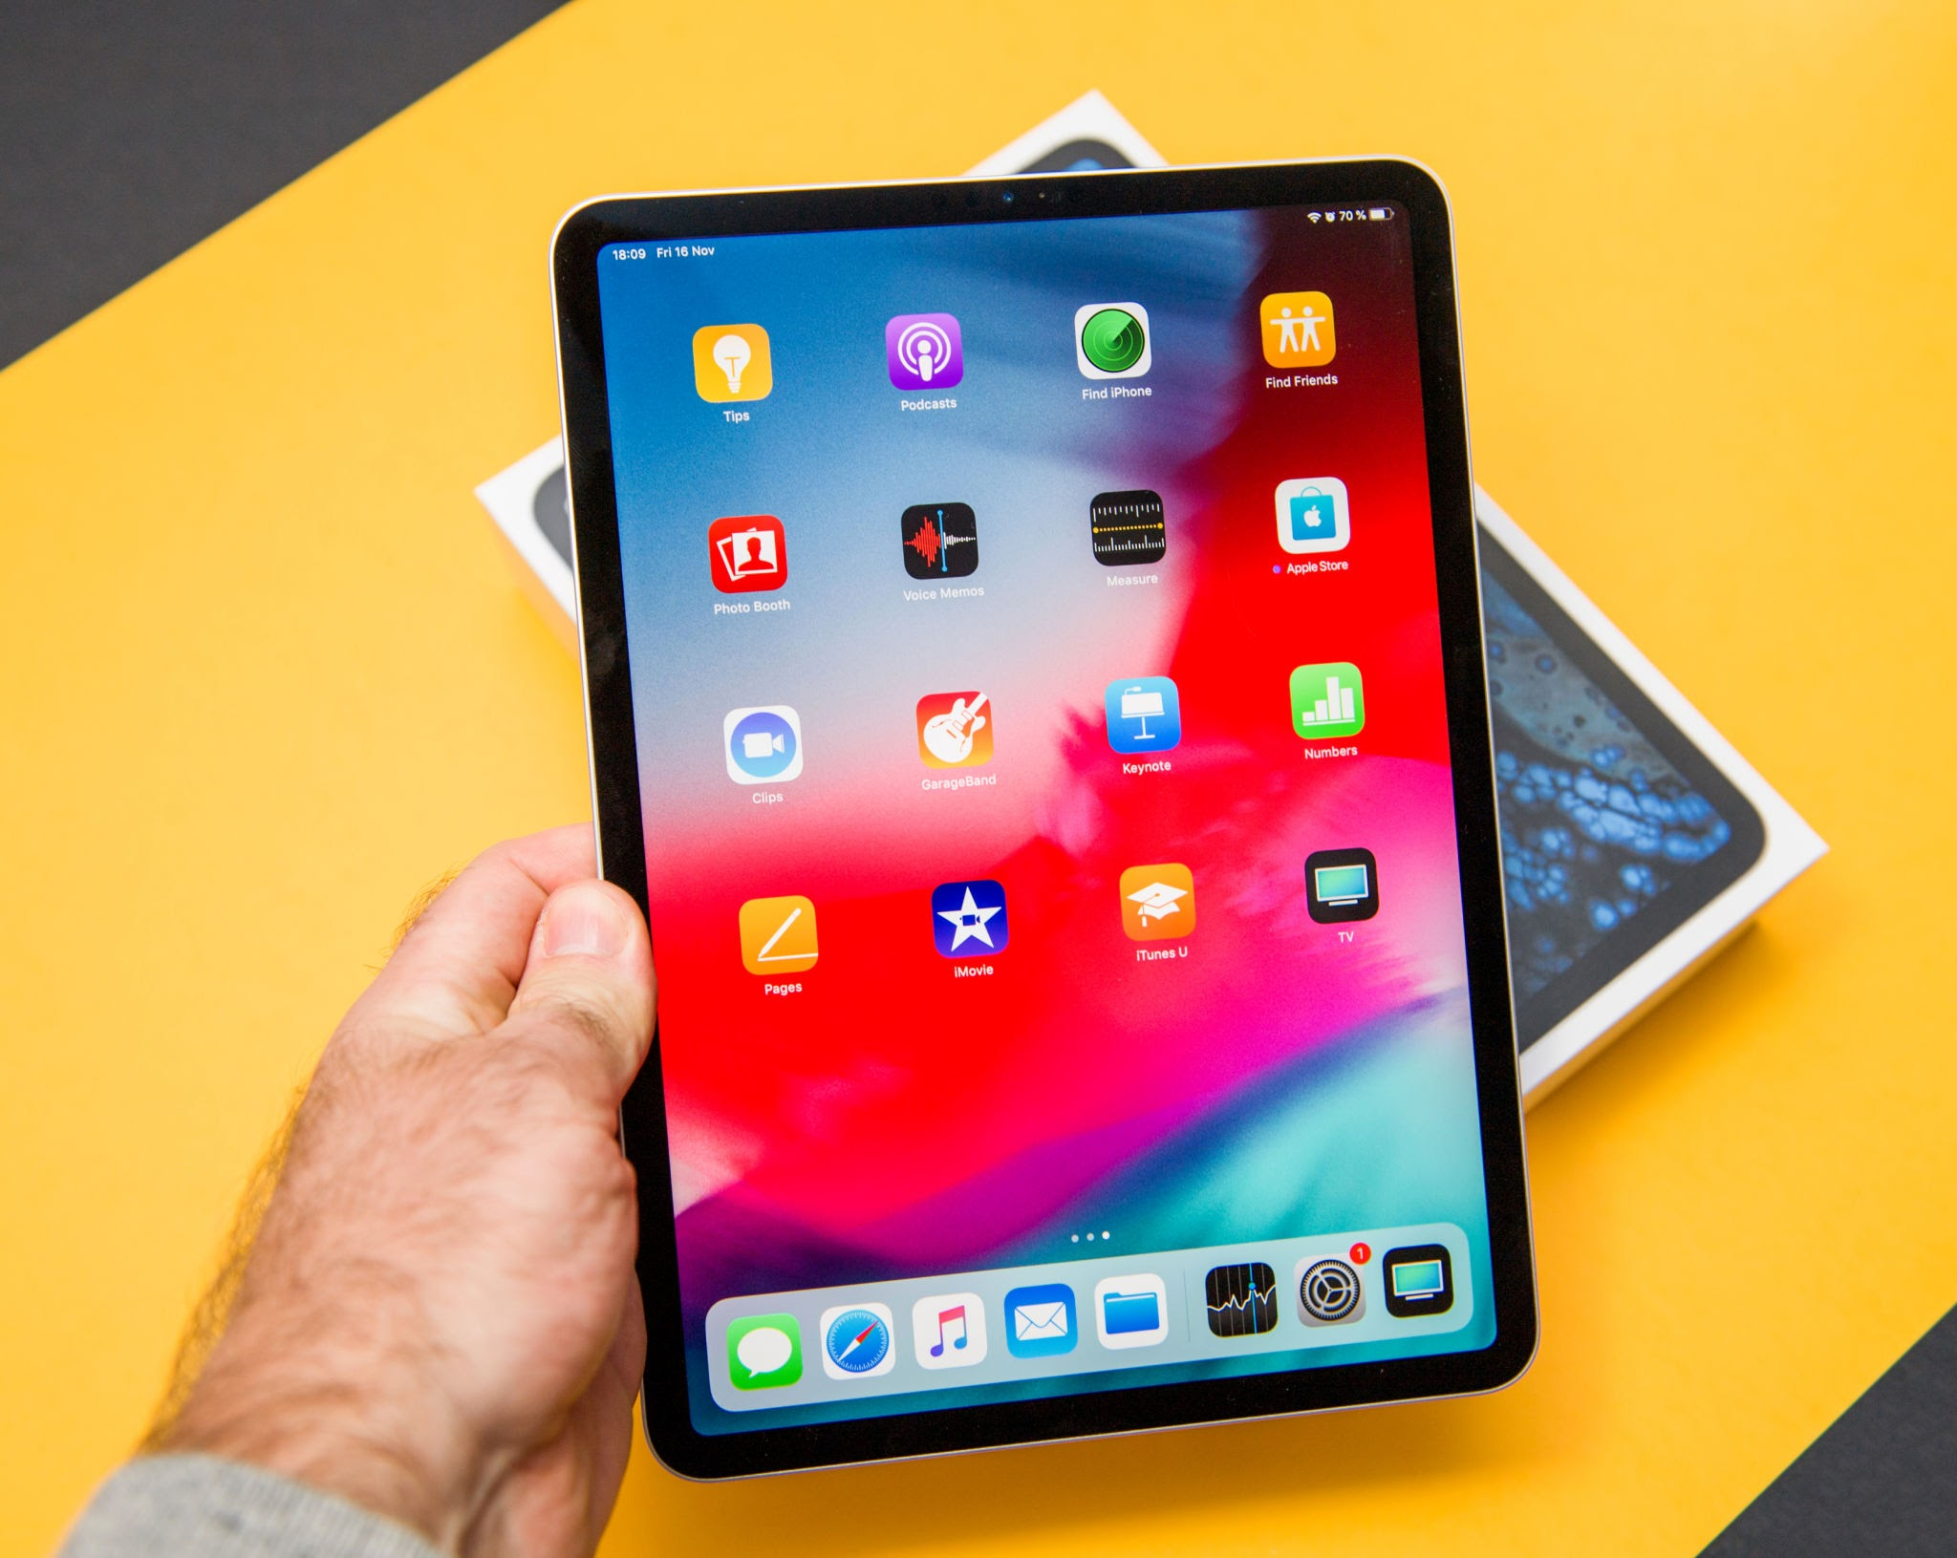
Notes:
Lesson flow:
Find seats via classroom screen
Connect devices to the wifi using the new passwords
Connect to Apple Classroom
Connect to Google Classroom
Complete Agreement form https://forms.gle/4EpEd23tDfAA4NqBA
Routines, behaviours and expectations
Wayground Quiz https://wayground.com/admin/quiz/68999e2e17eb2c98b5dd68fb
iPad skills builder activity

Slide 52
Setting up Apple Classroom
Turn WIFI on and connect to ‘EDUCATION’ network
Go to settings and look for the logo
Tap blue words Add/ join class e.g ‘3B ICT Mr Anthony’
Notes:
Student’s may not know their passwords yet. Provide them with the excel doc when provided by Maria

Slide 53
Setting up Apple Classroom
Enter the code you see on the screen
Write your first and last name
Tap add
ALLOW ALL permissions
Wait for teacher
X X X X
Notes:
Student’s may not know their passwords yet. Provide them with the excel doc when provided by Maria

Slide 54
Join Google Classroom
Join Class

Slide 55
Enter class code

Slide 56
Agree and sign on Google Forms
Notes:
If students do not have Google Classroom App installed then sign in via safari OR airdrop the link to the agreement to their device: https://forms.gle/4EpEd23tDfAA4NqBA

Slide 57

What do you already know?
Scan the QR code and take the iPad basic skills quiz and test your knowledge. If you score below 50% retake the quiz and try and beat your score!
Notes:
https://wayground.com/admin/quiz/68999e2e17eb2c98b5dd68fb
Quiziz is now called wayground!!!! Link is above, host and generate QR code

Slide 58
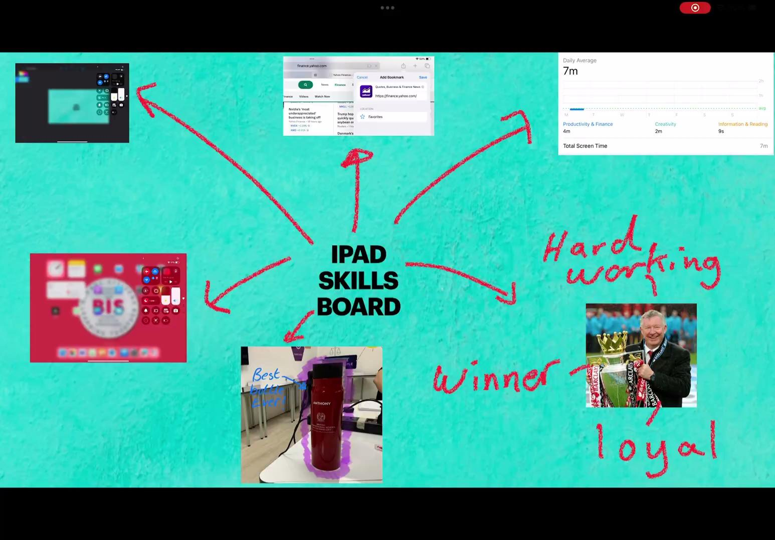



iPad skills builder
Complete the skills from the choice board and present them in an app of your choice. E.g. Freeform, Keynote, Canva, slides etc.
Look at the example!

Slide 59
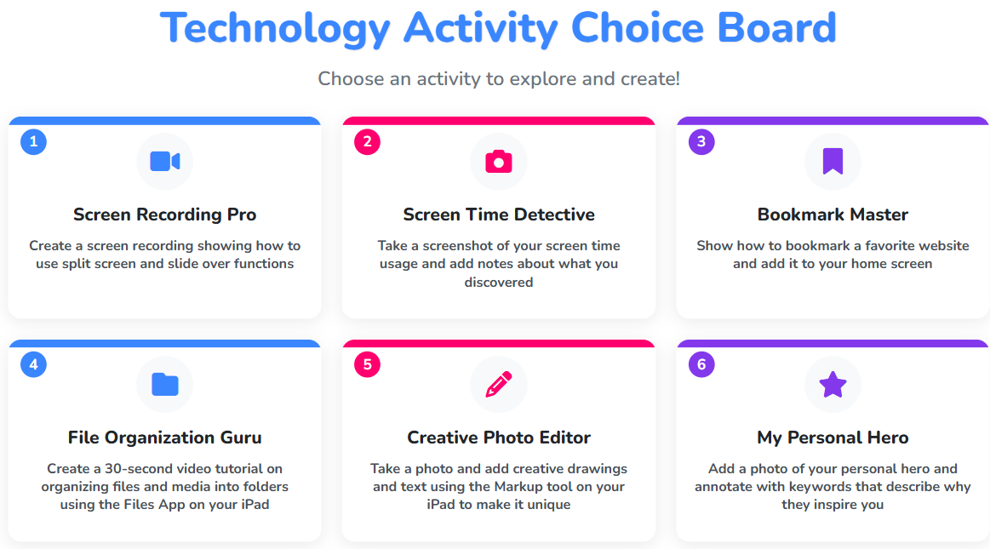

Slide 60
Welcome to the
DREAMS Lab
Y5/6
Laptops
Notes:
Lesson flow:
Find seats via classroom screen
Login into Computer -> Google Chrome
Connect to Google Classroom
Complete Agreement form https://forms.gle/4EpEd23tDfAA4NqBA
Routines, behaviours and expectations
Digital Skills Academy

Slide 61
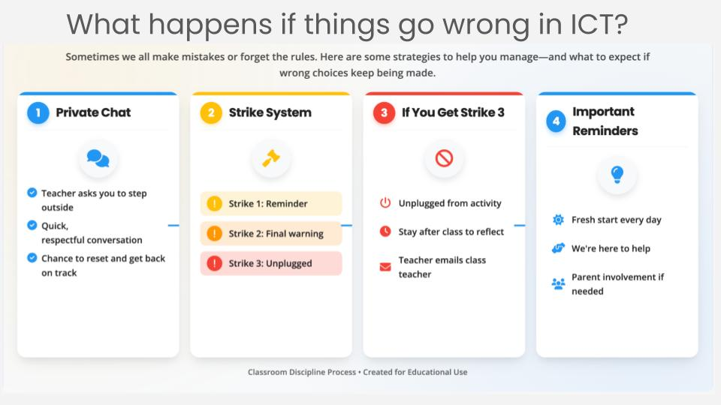

Slide 62
Your name
Notes:
Lesson flow:
Find seats via classroom screen
Login into Computer -> Google Chrome
Connect to Google Classroom
Complete Agreement form https://forms.gle/4EpEd23tDfAA4NqBA
Routines, behaviours and expectations
Digital Skills Academy

Slide 63
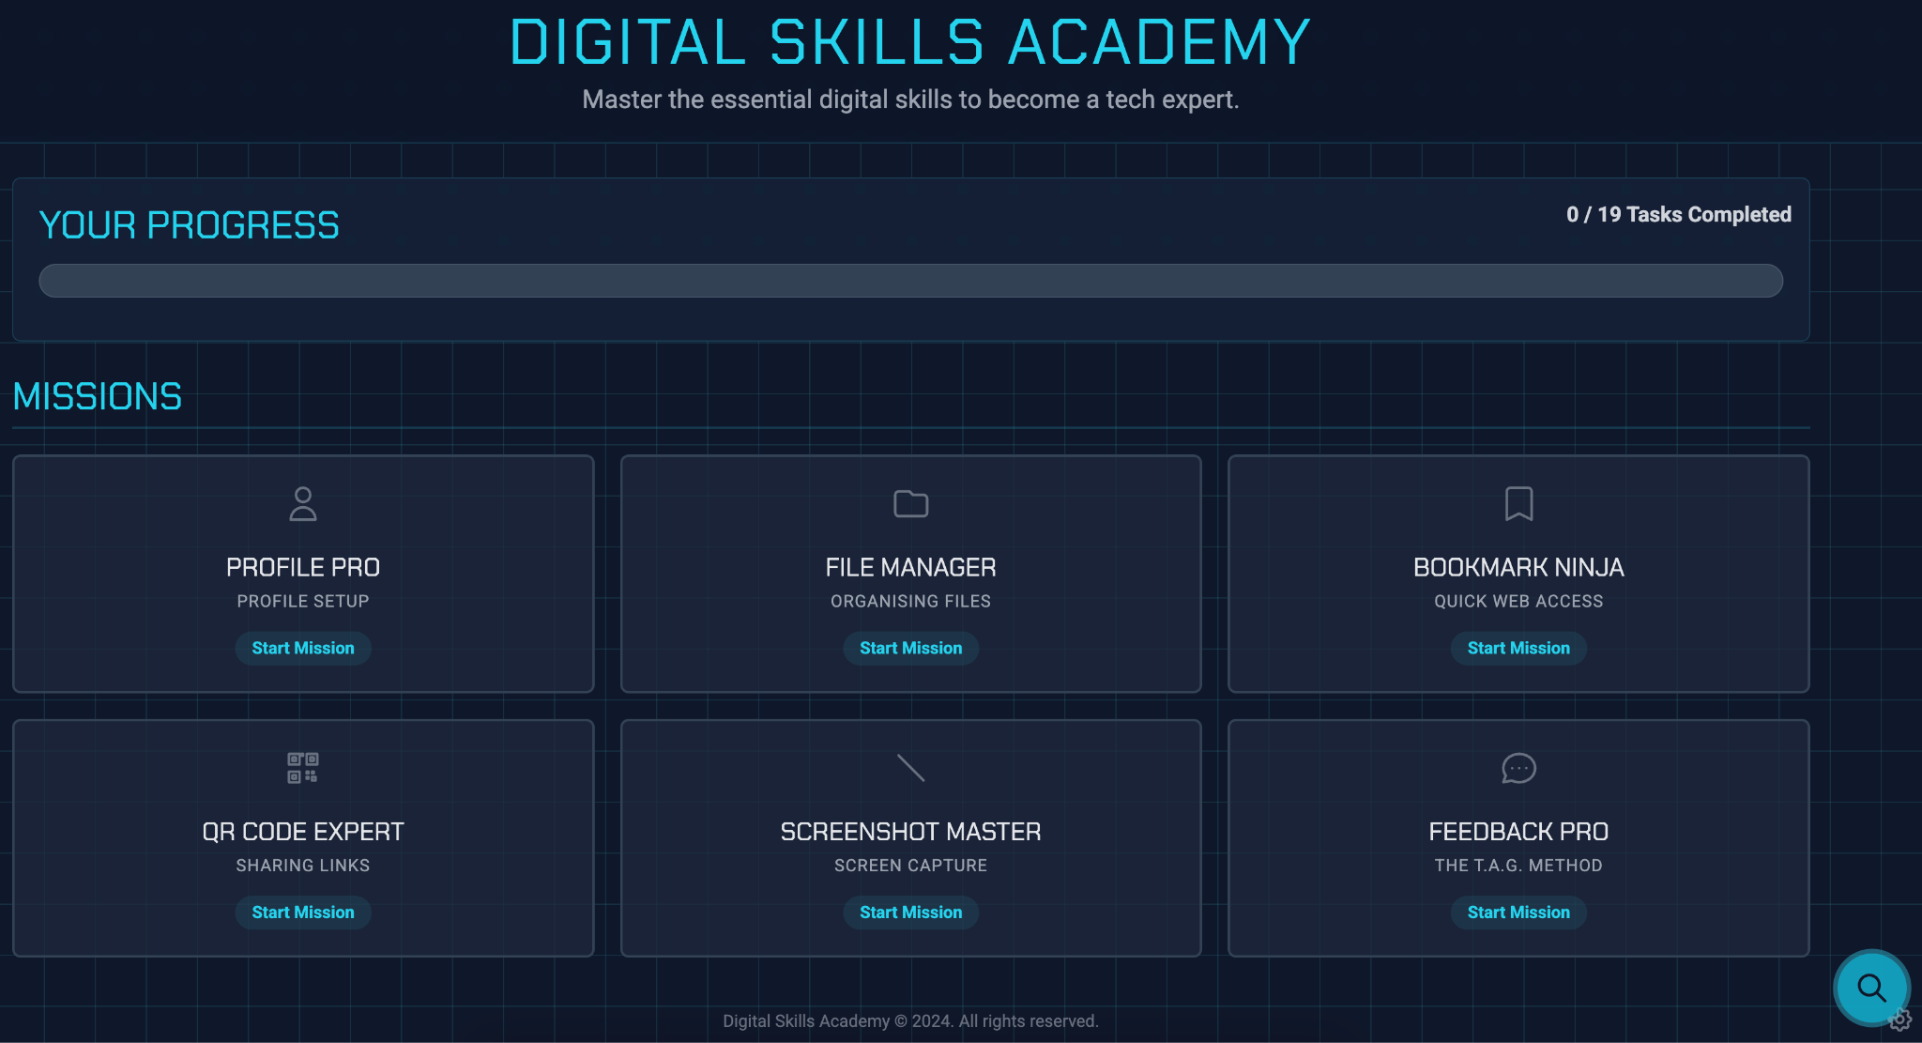
Notes:
https://digital-skills-academy-y5-6-801886913830.us-west1.run.app/
Lesson flow:
Find seats via classroom screen
Login into Computer -> Google Chrome
Connect to Google Classroom
Complete Agreement form https://forms.gle/4EpEd23tDfAA4NqBA
Routines, behaviours and expectations
Digital Skills Academy

